Slide 1
Serious Illness Decision Making Conversations & Advance Care Planning with POLST
Notes:
TO THE PRESENTER:
The content in these notes may be long for some slides. We’ve done this in order to provide as much information as possible to the presenter so that even if you are not as familiar with the POLST Paradigm you will have access to adequate explanations for important aspects of POLST.
Be sure to always present all the information on every slide. If you do not believe a slide is appropriate for your audience, you may hide it.
Look for *** to identify issues that, in our experience, are particularly challenging for clinicians to master; we recommend including the notes that are marked in this way in your spoken comments throughout your presentation.
Look for “SUGGESTED SCRIPT” where we provide ideas for what to say when presenting that slide.
Look for “SUPPLEMENTAL SCRIPT” where we provide ideas for what to say in addition to what it show on the slide.
Be sure to always present all the information on every slide. If you do not believe a slide is appropriate for your audience, you may hide it.

Slide 2
Permission to Use
This slide presentation may be used without permission. To promote consistency across the state, the slides may not be altered.
You may freely take language (but not screenshots) from this presentation to use in your own presentations.
Please send requests for institutionally specific modifications to polstIllinois@gmail.com.
Notes:
TO THE PRESENTER:
The POLST Illinois slide sets that are available on the website are locked so that we can maintain consistency of POLST IL-approved presentations. However, if you would like to create your own presentation you are welcome to reproduce contents of the slides; in that case, please do NOT use screenshots nor the official POLST logos.
These slides were created and are maintained by a generous group of volunteers across the state. Thank-you for your consideration.

Slide 3
Disclaimer
Note that this presentation provides clinical guidance for the POLST Paradigm and should NOT be construed as medical nor legal advice.
For answers to legal questions, check with your own legal counsel.
Notes:
TO THE PRESENTER:
***Please read the slide verbatim

Slide 4
Objectives
By the end of this session, participants will be able to:
Understand the communication techniques involved in the POLST Model
Complete a thorough POLST discussion prior to and during completion of an IDPH Uniform POLST form
Adjust your POLST program considering COVID-19
Describe the organizational quality practices that should be part of your institution’s POLST program
Notes:
TO THE PRESENTER:
In our experience, many clinicians, including first responders, hospice staff and nursing home staff, have misunderstandings about the use of the POLST form. We have discovered many intelligent and competent clinicians who misunderstand some of the basic POLST information, and who “don’t know what they don’t know”. We believe that this presentation will help people recognize and fill-in the gaps in their POLST knowledge base.
You will also find useful information on the POLST Illinois website in the form of the Guidance Document and FAQ Document.
Lastly, you may wish to air this 8 minute national POLST overview video (www.youtube.com/watch?v=zlqQgCBChn0#t=118) as a part of or in preparation for your presentation. A link is embedded in the first bullet point of this slide.

Slide 5
What is POLST?
In Illinois - POLST stands for Practitioner* Orders for Life Sustaining Treatment
It is NOT just a form, it is a process
Approach to end-of-life planning based on thoughtful conversations with the person, a friend or family if desired, and healthcare professionals
Incorporates values, beliefs and priorities as these relate to prognosis, likely disease course & treatment choices
* Physician, Advanced Practice Registered Nurse, Physician Assistant, Resident in 2nd year or higher of residency program
Advance Practice Registered Nurse
Physician Assistant
Resident in 2nd year or higher of residency program
Notes:
SUGGESTED SCRIPT:
POLST is a process that helps identify a patient’s wishes regarding medical treatment through conversation, after which the patient’s treatment wishes are documented as a portable medical order, called a POLST Form.
***In IL, the POLST form can be signed either by a physician, an APN, PA or medical resident who has completed 1 year in an endorsed residency program.
***The POLST form is the most visible part, but the process behind its completion is the most important part. The conversation between the patient and his/her health care professional should include the patient’s goals of care considering current diagnosis, prognosis, and treatment options (including risks and benefits of each). The result of the conversation may be the completion of a POLST form—or it may be a first step in the care planning process.

Slide 6
Who should have a POLST Form?
The POLST decision-making process and resulting medical orders are intended for people of any age who are at risk for a life-threatening clinical event because they have a serious life-limiting medical condition, which may include advanced frailty.
This includes but is not limited to people with:
Severe Heart Disease
Metastatic Cancer or Malignant Brain Tumor
Advanced Lung, Renal or Liver Disease
Advanced Frailty
Advanced Neurodegenerative Disease
(e.g., Dementia, Parkinson’s Disease, ALS)
Notes:
SUGGESTED SCRIPT:
***The POLST decision-making process and resulting medical orders are intended for patients who are considered to be at risk for a life-threatening clinical event because they have a serious life-limiting medical condition, which may include advanced frailty.
In order to assess whether a POLST conversation is appropriate for a person, clinicians should ask themselves “Would I be surprised if this person died within the next year?” If the answer is “No, I would not be surprised” then a POLST conversation, possibly resulting in completion of a POLST form, is appropriate.
***These persons include those with advanced illness and the frail elderly (including many persons in nursing homes who are there for custodial, not rehabilitative, care).
TO PRESENTER:
Patients with serious life-limiting medical condition or advanced frailty:
whose health care professional would not be surprised if they died within 1-2 years; or
who are at an increased risk of experiencing a medical emergency based on their current medical condition and who wish to make clear their treatment preferences, including about CPR, mechanical ventilation, ICU; or
who have had multiple unplanned hospital admissions in the last 12 months, typically coupled with increasing frailty, decreasing function, and/or progressive weight loss.

Slide 7
What else to know about a POLST?
Most people over age 65 are too healthy to have POLST orders.
POLST is not intended for people with chronic, stable disability, who must not be mistaken for being at the end of life.
The POLST form speaks for patients ONLY when they can’t speak for themselves.
The patient can void or change their POLST form at anytime as their disease and health changes.
A patient without POLST orders receives FULL TREATMENT as the default, and this may be a reason not to complete the form.
Accompanies patient from care setting to care setting
Notes:
SUGGESTED SCRIPT:
Most 65-year-olds are too healthy to have POLST orders.
***POLST is not intended for people with chronic, stable disability, who should not be mistaken for being at the end of life. POLST would only be appropriate for people with chronic disabilities if the person’s health deteriorates such that death within a year would not be unexpected.
The form is only used when the patient is unable to communicate for themselves.

Slide 8
What are the benefits of POLST?
Promotes Person-Centered Care
Allows the person, loved ones and providers to discuss and document the person’s values and preferences for treatment in a medical emergency
Protects individuals who live in the community from treatment that is inconsistent with their preferences
Reduces medical errors by improving guidance during life-threatening emergencies
Notes:
TO THE PRESENTER:
Review slide as written

Slide 9
POLST Conversations

Slide 10
Checklist for the POLST Conversation
Use simple language
Start with a DISCUSSION, then end with the POLST form itself
Inform that POLST form is optional and can be changed at any time
Explain under what circumstances the form might be useful
Ensure that patient/decision maker has full information to make each decision
Notes:
SUPPLEMENTAL SCRIPT:
The person who discusses the POLST model with the patient does not have to be the signing practitioner. Other members of the interdisciplinary team who are appropriately prepared with the knowledge base and communication skills can have the conversation, but the person who signs the form must be the patient’s attending practitioner (doctor, APN, PA, non-intern resident)
It is important to lay out different potential circumstances when the POLST might be used.
Since the POLST form has medical terms not all people understand, it is important that health care professionals share information about treatment options utilizing language and tools (e.g., videos or visuals) that help patients and families grasp the impact of their decisions. Then, it is the task of the health care professional to translate the individual’s goals of care, priorities, and wishes into medical orders using the language of medical professionals. Patients and decision makers should also be told that they can void and change the POLST form in the future if things change.
NOTES FOR COACHING A POLST CONVERSATION:
If appropriate to the audience, you can suggest/discuss ways to set-up the discussion with patients/families:
POLST is not for everybody, we are discussing it with you because…
It’s important that we know ahead of time, what your wishes are if you get really sick and there is a medical emergency where you cannot talk for yourself.
The POLST form documents in writing your wishes for your care in critical medical situations.
I want to make sure you have the knowledge to make decisions based on your current health issues.
Once the form is signed by you/decision maker, witness and practitioner, the form becomes a medical order. This requires all other healthcare professionals to follow the orders.
If at any time your medical situation changes, or if your wishes change, your POLST form can be changed.

Slide 11
POLST Conversation – BEFORE the Form
Review relevant medical facts; uncovering gaps in person’s understanding of prognosis
Explore experiences; identifying fears and concerns
Awareness of potential complications resulting from illness
Awareness of potential emergency treatments of these complications (e.g., CPR, intubation, hospitalization in ICU)
Ask patient to reflect on goals/values and how they influence preferences
And then, put the preferences in writing to translate them into actionable medical order
Notes:
TO THE PRESENTER
***To begin, the patient or their substitute decision maker and the healthcare provider discuss the patient’s goals of care considering his/her current diagnosis, prognosis, values around quality of life, concerns about the future and treatment options (including risks and benefits of each).
SUPPLEMENTAL SCRIPT
Review the medical facts around the patient’s current health.
The goal is to understand what the patient/SDM knows.
If their understanding is not consistent with their prognosis, alert the appropriate practitioner, so they can clarify.
2. Explore the patient’s/SDM’s experiences regarding serious illness.
Awareness complications that might occur
Awareness of how successful emergency treatments are and what complications are likely
3. Ask about
What patient values most
What concerns they have about the future
What goals of they have around quality of life

Slide 12
Knowledge GAP - Decision Point
Non-practitioner POLST conversation reveals one or more:
Diagnosis/prognosis not understood
Family member/s and patient/proxy not on the same page
Risks & benefits of POLST treatment options not understood
Patient/proxy wishes are significantly different than anticipated
Other substantial conflicts arise during the POLST conversation
IF YES -
Refer to medical practitioner for additional, appropriate clinical information
IF NO –
Continue to discuss POLST Form
Notes:
TO THE PRESENTER
Non-practitioners should not be communicating information about the patient’s clinical status during a POLST conversation. If the patient or their decision maker does not have the necessary information to make a well-informed decision about treatment, that person should be referred to the attending or primary practitioner to fill in any knowledge gaps before completing a POLST form.
SUPPLEMENTAL SCRIPT

Slide 13
Case Studies
A 60 y/o with metastatic cancer who was recently hospitalized, and a POLST conversation is being conducted before he is discharged home. He recognizes his illness is terminal and does not wish to undergo CPR in case of cardiac arrest. He also does not want to be intubated should he suffer a primary respiratory arrest. However, as his quality of life is still good, he is willing to attempt low burden, less-invasive measures to prolong his life. REFER FOR MORE INFO?
A 78 y/o with late-stage COPD and frailty who, while hospitalized, was intubated and successfully extubated. A POLST conversation is conducted with the patient and, with his permission, his brother, who is also the patient’s POAHC, before the patient returns to his skilled nursing facility. The patient believes that should he suffer a cardiac arrest, the odds of his surviving an attempt at resuscitation are slim, and he does not wish to have CPR attempted. He is unsure about being intubated again should he suffer a potentially reversible condition, such as a pneumonia, but seems to prefer to stay at the SNF rather than go to the hospital. His brother feels very strongly that the patient should be full code, he survived the ICU once and will again. REFER FOR MORE INFORMATION?
Notes:
No – ask group why.
Yes – ask group why.
Disagreement between the patient and the POAHC; Bother has a misunderstanding about the risks and benefits of CPR and intubation for the patient.

Slide 14
Demonstrating That You Care
Always approach with compassion
Ask for permission to proceed with difficult discussions
Encourage understanding between patients and family members
Hearing the information for the first time is hard.
It’s normal to need time to think things through.
Use multiple conversations as needed.

Slide 15
Resources for “The Conversation”
https://www.theconversationproject.org/
https://respectingchoices.org/
https://pact.northwestern.edu/
https://www.vitaltalk.org/
https://www.capc.org/documents/728/
https://coalitionccc.org/tools-resources/decision-aids/
https://www.medicalimprov.org/about
Notes:
TO THE PRESENTER:
Share these websites and resources for learning how to conduct a POLST goals of care discussion with patients and surrogate decision makers.

Slide 16
Adapted from Vital Talk: Patient Engagement Opportunities
Patient | Healthcare Provider
"I want everything possible; I want to live." | "We are doing everything we can. This is a difficult situation. Could we step back for a moment so I can learn more about you? What do I need to know about you to do a better job taking care of you?"
"I don't want to end up being a vegetable or on a machine." | "Thank you for sharing that with me. It is very important for me to know that. Can you tell me more about what you mean?"

Slide 17
Adapted from VitalTalk: Substitute Decision Maker Engagement Opportunities
POAHC/Surrogate | Healthcare Provider
"I don't think my spouse/family member would have wanted this." | "OK, let's pause for a moment and talk about what they would have wanted. Can you tell me what they considered most important in their life? What meant the most to them, gave their life meaning?"
"I am not sure what my spouse/family member wanted - we never spoke about it." | "Many people find themselves in these kinds of difficult situations. To be honest, it is very difficult to hear, yet given their overall condition, the odds are against us. If we place them on a breathing machine or do CPR, their chances of surviving are... I know this is difficult to hear and talk about. Can you share your thoughts with me?"

Slide 18
Discussion of the POLST Form

Slide 19
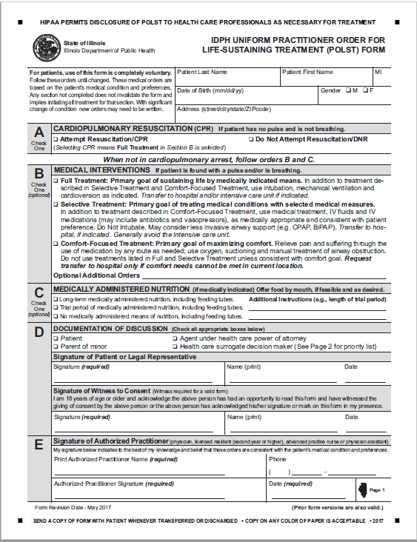
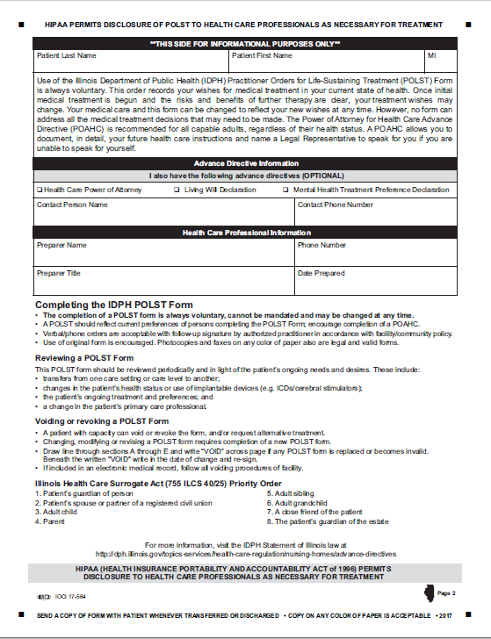
The IDPH Uniform POLST Form
Notes:
TO THE PRESENTER:
Please review the form’s general layout. Additional details on each section are broken down over the next few slides.
SUGGESTED SCRIPT
This is the current document, revised as of 2017
***It is important for healthcare professionals to explain that if a form does not exist – then full treatment including CPR is the default. If the person wishes to have all life sustaining treatment/CPR, then they should seriously consider not completing a POLST form until their health status and/or preferences change.

Slide 20
3 Primary Medical Order Sections
If NO pulse and NO breathing: CPR wishes
Attempt resuscitation
Do Not Attempt resuscitation (DNR)
If pulse and/or breathing are present: Care wishes
Full Treatment
Selective Treatment
Comfort-Focused Treatment
Medically Administered Nutrition
Acceptable
Trial Period
None
Notes:
TO THE PRESENTER:
Review this slide as the general outline of decision categories in the IDPH POLST form

Slide 21
Section “A”: Cardio-Pulmonary Resuscitation
Section A documents what a person wishes to occur if they are found with no pulse and not breathing.
The presence of a POLST form DOES NOT mean DNR. Patients can use a POLST Form to indicate “Attempt Resuscitation” as well as “Do Not Attempt Resuscitation”.
If “Attempt Resuscitation/CPR” box checked: Start CPR and full cardiac arrest care per local protocol.
If “DNR” box checked: Do NOT begin CPR.
Notes:
SUGGESTED SCRIPT:
***SECTION A describes what the patient wishes to happen if they are found to have NO pulse and NOT breathing. In other words, death has essentially occurred, and providers would need to attempt resuscitation for the patient to have a chance of surviving. The person should be clear that this section only comes into play when the patient has essentially died. All other situations will be covered in another part of the form.
EXPLAINATION TO INDIVIDUAL COMPLETING FORM
This section of the form allows you to document what you/the patient will want if your/the patient’s heart completely stops, you/the patient are/is not breathing and have/has in effect, died a natural death. In that situation, a medical procedure called Cardiopulmonary Resuscitation (CPR) can be tried to restart your/the patient’s heart. Unfortunately, CPR is not as successful as most people think, especially for people who are weaker and sicker. In this situation, CPR works a small amount of the time. If your/the patient’s heart is restarted by CPR, it normally requires being in the Intensive Care Unit. There is also the possibility that CPR may cause serious side effects, and it will not cure the original medical problem.
Do you have any questions? What ideas do you have about discussing Section A?
If CPR is desired – Mark “Attempt Resuscitation/CPR” in section A. Go to section B.
If DNR is desired – Mark “Do Not Attempt Resuscitation/DNR” in section A. Go to section B.

Slide 22
Acceptable Options for a Valid Form
Section A
Section B
Yes! Do CPR
Full Treatment
Full Treatment
DNR: No CPR
Selective Treatment
Comfort-Focused Treatment
Notes:
TO THE PRESENTER:
It is sometimes difficult for people to understand why a person cannot choose “Attempt CPR” in section A and then choose “Do Not Intubate” in Section B.
SUGGESTED SCRIPT:
***A common mistake in completing the POLST form is when a practitioner and their patient/proxy selects Yes to CPR in Section A, but does not select Full Treatment in Section B.
This combination is NOT COMPATIBLE.
A person who wants all possible treatment if they have died (no pulse or heartbeat) would also want all possible treatment before they have died. In other words, a person would not want to WAIT until they had died to receive full treatment. That would not make sense.
Additionally, a person may request that CPR be attempted, but wish to REFUSE intubation. Often this choice is motivated by fear of letting go and lack of understanding that CPR leading to restoration of spontaneous circulation will almost 100% lead to a need for intubation at least for a short while. The POLST conversation should focus on patient’s ACHIEVABLE GOALS (as opposed to focusing on individual treatment choices to start with), as well as helping patients or proxies recognize disconnect of a CPR – DNI order.
Therefore, if “Yes to CPR” is selected in Section A, then “Full Treatment” must be selected in Section B. A person cannot choose “Attempt CPR” in section A and then choose “Do Not Intubate” in Section B.
If “DNR; No to CPR” is selected in Section A, then any choice can be selected in Section B.

Slide 23
Section “B”: Medical Interventions
Section B documents what a person wishes to occur if they are found with a pulse and/or breathing present but unable to communicate; cardiac arrest may occur shortly. a pulse and/or are breathing:
The checked box explains patient’s goal for treatment and specifies which treatments the patient wants to have and avoid.
Notes:
SUGGESTED SCRIPT:
*** Section B applies in medical emergencies ASIDE FROM CARDIAC ARREST sometimes called a PREARREST EMERGENCY. These are situations when there is a heartbeat and breathing, but one, the other or both are deteriorating. These situations could lead to cardiac arrest if not responded to medically. The question in these circumstances is not whether the patient wants to be resuscitated, but rather what level of treatment or what medical interventions the patient wants—or does not want.
We will go into more specifics on the next slide.
TO THE PRESENTER:
If appropriate to the audience, suggest/discuss ways to introduce section B:
In a situation when you/the patient are critically ill and not able to communicate, but you have a pulse or are breathing, then medical professionals would look at Section B on a POLST form.
Section B is very important—it is the heart of POLST.
People who want to be DNR in Section A, choose all different options in Section B, so we need to discuss what you/the patient would want in this situation.

Slide 24
Section “B”: Medical Interventions
Full Treatment: Transfer me to the hospital and provide all appropriate treatment. I want to live as long as possible.
Must be selected when selecting CPR in section A
Either box may be marked in Section A
Notes:
SUGGESTED SCRIPT:
***Reiterate - It is very important to understand that Sections A & B are used in different situations, so DNR in Section A does not determine care when a person is critically ill but with a pulse and/or is breathing. In these medical emergencies, first responders will follow the orders in Section B.
SECTION B: Full Treatment - includes all medically indicated treatments for sustaining life including intubation, ventilation, cardioconversion, dialysis, surgery, etc. This will almost always mean transferring the patient to the hospital and providing care in the ICU if needed.
Here is an example -the same patient who chooses DNR in Section A, may also believe that if they are choking or having a severe asthma attack and are in need of an in-line neb or an advanced airway that would save their life and preserve their neurologic function, they may choose Full Treatment in Section B. In Section B, Full Treatment is not meant to also apply to cardiac arrest management.
Another example: let’s say someone has pneumonia and develops septic shock. They are willing to have all medical treatment aimed at reversing these processes. But given their severe, inoperable CAD, they understand that, should they have a cardiac arrest, even as a result of the sepsis, their prognosis for recovery significantly lowers. So they would like to try antibiotics, pressors, be in the ICU, on a vent if necessary, but would not want ACLS should their heart stop. That would be a situation where they would mark No CPR in section A and Full Treatment in Section B.
Please note, if a person chooses Attempt Resuscitation/CPR in section A, then the practitioner must mark – “Full Treatment” in Section B. To understand this, think about a person close to death who want CPR, you would not wait until after they died to try to save their life – you would give them all indicated treatments right away.
Do you have any questions?
EXPLAINATION TO INDIVIDUAL COMPLETING FORM
If yes to CPR in Section A –
Since you have chosen to have emergency medical professionals attempt to resuscitate you/the patient by giving CPR when there is no pulse or breathing, then it follows that you also want full treatment if your/the patient’s heart has not stopped beating, no matter how critical your/the patient’s condition. Does this make sense?
If NO CPR in Section A:
It is important to understand each person’s goals and wishes to determine the best option in section B.
As your/the patient’s illness progresses, it is possible you/the patient may have critical health problems. If you/the patient got so sick that you/the patient were struggling to breathe, you/the patient might need to be put on a ventilator, which is a machine that will helps the lungs. The ventilator is not comfortable and will prevent you/the patient from communicating with people. Also, you/the patient would need to be in the intensive care unit of the hospital.
If you/the patient were that sick, would you/they want to go to the hospital and be placed on the ventilator?
If YES to Ventilator in Sec. B: Mark - Full Treatment, and continue:
If you/the patient are/is on the ventilator and not improving, and the doctor thinks your/their chances of getting better are very small, would you/the patient want to be kept alive on the ventilator for long time?
IF YES – do nothing else in section B. Go to section C.
IF NO – Add:
If your doctor does not think you are going to make a good recovery, we can write in Additional Orders – “Trial period to meet your goals. Does that make sense?
Complete the optional additional orders section.

Slide 25
Section “B”: Medical Interventions
Selective Treatment: Transfer me to the hospital for medical treatment, but I do not want to be on the ventilator.
Person could receive treatments such as:
IV fluids; IV meds as appropriate
May use CPAP, BiPAP, BVM
Other treatments as needed to return to “baseline”
Notes:
SUGGESTED SCRIPT:
*** SECTION B: Selective Treatment – in general this means some or most indicated treatments will be provided to the patient except intubation/ventilation. For patients who choose this option, the goal is to avoid the ICU but attempt to return as much as possible to their baseline. Note that vasopressors can only be done in the ICU setting but may still be indicated under “Selective Treatment”. It may be especially important to discuss the specific treatments the patient wants and does not want if this option is chosen, for example – radiation/chemotherapy, dialysis, major surgery, etc.
An example of using this option is a patient with heart failure having severe shortness of breath. They may want a trial period of CPAP/BiPAP (IF INDICATED) but do not want to be intubated. This patient may be far more comfortable if we can provide noninvasive pressure support ventilations and/or position them appropriately to relieve their distress. King LTD, LMA, Combi tube are other examples of advanced airways that the patient generally intends to refuse if this box is marked.
Do you have any questions?
EXPLAINATION TO INDIVIDUAL COMPLETING FORM
If NO to ventilator in Sec. B:
I understand you/the patient would not want to be put on a ventilator.
Some people still wish to go to the hospital for certain treatments if they will be able to recover and have a quality of life that is acceptable to them.
Other people reach a point when they would prefer not to go back to the hospital. They would prefer to stay home.
Tell me how you feel about your/the patient’s current quality of life and what kinds of treatment you/the patient would be willing to go through.
Determine if the person wants the types of medical treatments described in the “Selective Treatment” section. Explain these treatments as needed giving the person information about each treatment’s possible benefits and drawbacks. Use “optional Additional Orders” to indicate specific treatments the patient wishes to have or avoid and if a trial period is requested.
Mark - Selective Treatment: for persons wishing to be hospitalized (may include medical treatments including IV fluids and IV medications, and/or less invasive airway support) Specify any treatments to avoid in “Optional Additional Orders.”
Mark- Comfort-Focused Treatment: for persons wishing to stay at home and be kept comfortable without significant medical treatments.

Slide 26
Section “B”: Medical Interventions
Comfort-Focused Treatment: I want to be as comfortable as possible where I am but transfer me to the hospital if my pain or symptoms cannot be alleviated.
Notes:
SUGGESTED SCRIPT:
*** SECTION B: Comfort-Focused Treatment – this option is focused on relief of pain and other distressing symptoms rather than prolonging life. Interventions listed in Full and Selective Treatments will not be used if this option is selected. Transfer to a hospital should be avoided unless it is needed for symptom management.
A good example of this would be a hospice patient. “Please keep me out of pain but let me die at home.” One of the problems that EMS personnel face is being called to a home because the family does not know what to do when the patient deteriorates and end of life appears imminent. EMS responds and the family requests help, but they do not know what that help should be. EMS usually has to transport the patient even though patient’s wish is to not be transported. There is now a caveat written into the form states, “Transfer to hospital only if comfort needs cannot be met in current location.”
Any questions
EXPLAINATION TO INDIVIDUAL COMPLETING FORM
“Comfort-focused treatment” does not mean that you/patient will go without care. – Any condition that makes you/patient uncomfortable will be addressed to make you/patient as comfortable as possible. This may even mean going to the hospital if necessary, to relieve suffering.

Slide 27
Section “B”: Comfort Focused Treatment
“Comfort-focused treatment” requires a clear explanation to the patient/substitute decision-maker:
Regardless of the option selected in section B, treatment for comfort is always provided – we never do nothing!
For example, if a person is choking, suction, manual treatment of airway, Heimlich maneuver would be implemented:
Choking is NOT COMFORTABLE!!
Notes:
SUGGESTED SCRIPT:
It is important to remember that -
No matter what treatments are indicated on the POLST Form, comfort care will always be provided so that the patient’s pain and other symptoms are managed.
Comfort-focused treatment can last for minutes, hours or days depending on the nature of the medical condition.
“Comfort-focused treatment” does not mean that certain conditions won’t be attended to – any condition that make the patient uncomfortable will managed in order to relieve suffering as much as possible. This might mean transporting the patient to the hospital if necessary.

Slide 28
Section “B”: Medical Interventions
Optional Additional Orders - used to customize form for individual medical conditions when necessary
Notes:
SUGGESTED SCRIPT:
This is where the health care professional preparing the POLST form with the patient/substitute decision-maker can indicate specific treatments that should or should not be used and/or what circumstances should be considered in treatment decisions.

Slide 29
Section C: Medically Administered Nutrition
Although it isn’t critical for emergency care, it is very helpful for healthcare providers to know your wishes about feeding tubes, called medically administered nutrition.
Yes, I do want long-term artificial nutrition if I am no longer able to take foods or liquids by mouth
Trial period, I do want artificial nutrition for a trial period (see additional instructions)
No, I do not want long-term artificial nutrition if I am no longer able to take foods or liquids by mouth
Notes:
SUGGESTED SCRIPT:
*** Section C applies only in situations when the patient cannot communicate with medical professionals and when a feeding tube is being considered and is medically indicated.
Medically administered nutrition represents a considerable change in the patient’s way of life, so this section allows for a medical professional to discuss the patient’s goals of care and willingness to accept a feeding tube prior to a medical event that would necessitate this treatment.
The patient can choose to
Have a feeding tube over the long-term
Have a feeding tube for a trial period (indicating goals for the trial period) or
Refuse a feeding tube in all circumstances

Slide 30
Section D: Documentation of Discussion
Need 2 signatures here
Patient, agent (POAHC), or healthcare surrogate
Witness to consent
If consented by patient’s legal representative, supporting documents verifying agent powers are NOT needed by EMS
Notes:
Anyone can witness the DNR/POLST form. The only restriction is that it cannot be the “Primary Care Giver”. The primary care giver is the practitioner that is directing the patient’s care. All other medical personnel are carrying out the practitioner’s orders so can witness the form if needed.

Slide 31
Section E: Signature of Practitioner
Must have practitioner’s name, signature, and effective date to be valid. Verbal orders are allowable.
Practitioner’s signature may be written by a nurse who adds her/his own initials - acceptable and form is valid

Slide 32
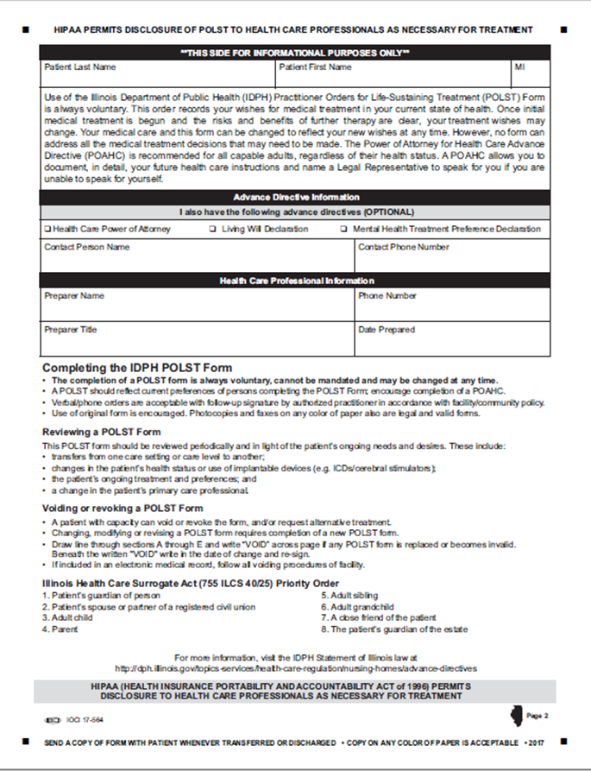
Back Page – EMS does not take action
Completing the back page of the POLST form is optional
Form is valid if only first page.
Information is helpful in identifying next of kin/emergency contact information.
Notes:
SUGGESTED SCRIPT:
The back page of the IDPH Uniform POLST Form is for informational purposes only. ***The form is valid even if left blank or not included.
Fields on the back page include:
patient’s name
information about the existence of the patient’s advance directives
identity of the person who conducted the POLST conversation and prepared the form with the patient or substitute decision maker
Guidance at the bottom of the back page includes information about:
Completing a POLST Form
Reviewing a POLST Form periodically after completion
Revoking or voiding a POLST Form
The IL Health Care Surrogate Act order of priority for decision makers

Slide 33
Review and Revision of POLST
POLST forms should be reviewed and updated periodically when the patient:
is transferred between ICU and general medical unit;
has a substantial change in clinical condition;
changes treatment preferences or goals of care
The POLST conversation should be repeated before documenting new treatment decisions or confirming current treatment decisions

Slide 34
QUESTION & ANSWER

Slide 35
POLST Resources
For POLST Illinois information:
polstIllinois@gmail.com
www.polstil.org
National POLST Program
www.polst.org
Notes:
TO THE PRESENTER:
Review information on the slide and ask for final questions. Any outstanding issues can be communicated to IL POLST through the website.

Slide 36
This presentation created by the POLST Illinois Education Committee has been made possible by in-kind and other resources provided by:
Notes:
Our logo
National logo & IL-HPCO

Slide 37
Additional Criteria for Evaluating Appropriate Use of POLST
Patients with a serious life-limiting medical condition or advanced frailty:
whose health care professional would not be surprised if they died within 1-2 years; or
who are at an increased risk of experiencing a medical emergency based on their current medical condition and who wish to make clear their treatment preferences, including about CPR, mechanical ventilation, ICU; or
who have had multiple unplanned hospital admissions in the last 12 months, typically coupled with increasing frailty, decreasing function, and/or progressive weight loss.

Slide 38
National Support for POLST:
Landmark Study JAGS 2014
Study on the relationship between what POLST orders are selected and where people ultimately die. 18,000 death records (2010-2011) reviewed from Oregon’s electronic POLST registry
Relationship between options selected on the POLST form and where people die:
6.4% of persons who had a POLST Form specifying Comfort Measures Only treatment wishes died in a hospital
22.4% for persons who wished for Limited Additional Interventions died in a hospital
44.2% of persons whose POLST specified wishes for Full Treatment died in a hospital
34.2% of persons without a POLST Form died in a hospital
(Fromme, Erik, et.al., “Association Between Physician Orders for Life-Sustaining Treatment for Scope of Treatment and In-Hospital Death in Oregon”, JAGS, Vol. 62, No. 7, July 2014, pp 1246–1251.)
Notes:
TO THE PRESENTER:
Review study explained on the slide.
Researchers examined 18,000 death records of individuals having a valid POLST form in the Oregon POLST Registry who had died of natural causes in Oregon between 2010 and 2011. The study compared the treatment wishes recorded on the person’s POLST Form to their location of death.

