Slide 1
Emergency Medical Services & First Responder Audience
Notes:
TO THE PRESENTER:
The content in these notes may be long for some slides. We’ve done this in order to provide as much information as possible to the presenter so that even if you are not as familiar with the POLST Paradigm you will have access to adequate explanations for important aspects of POLST.
Be sure to always present all the information on every slide. If you do not believe a slide is appropriate for your audience, you may hide it.
Look for *** to identify issues that, in our experience, are particularly challenging for clinicians to master; we recommend including the notes that are marked in this way in your spoken comments throughout your presentation.
Look for “SUGGESTED SCRIPT” where we provide ideas for what to say when presenting that slide.
Look for “SUPPLEMENTAL SCRIPT” where we provide ideas for what to say in addition to what it show on the slide.
Be sure to always present all the information on every slide. If you do not believe a slide is appropriate for your audience, you may hide it.

Slide 2
Permission to Use
This slide presentation may be used without permission. To promote consistency across the state, the slides may not be altered.
You may freely take language (but not screenshots) from this presentation to use in your own presentations.
Please send requests for institutionally specific modifications to polstIllinois@gmail.com.
Notes:
TO THE PRESENTER:
The POLST Illinois slide sets that are available on the website are locked so that we can maintain consistency of POLST IL-approved presentations. However, if you would like to create your own presentation you are welcome to reproduce contents of the slides; in that case, please do NOT use screenshots nor the official POLST logos.
These slides were created and are maintained by a generous group of volunteers across the state. Thank-you for your consideration.

Slide 3
Disclaimer
Note that this presentation provides clinical guidance for the POLST Paradigm and should NOT be construed as medical nor legal advice.
For answers to legal questions, check with your own legal counsel.
Notes:
TO THE PRESENTER:
***Please read the slide verbatim

Slide 4
Objectives
By the end of this session, participants will be able to:
Understand the POLST Model and how a person’s wishes are determined and documented in a standard form;
Describe how POLST form builds upon and improves existing advance directives
Advocate for patients by accurately interpreting IDPH POLST form instructions and taking appropriate action
Notes:
TO THE PRESENTER:
In our experience, many clinicians, including first responders, hospice staff and nursing home staff, have misunderstandings about the use of the POLST form. We have discovered many intelligent and competent professionals who misunderstand some of the basic POLST information, and who “don’t know what they don’t know”. We believe that this presentation will help people recognize and fill-in the gaps in their POLST knowledge base.
You will also find useful information on the POLST Illinois website in the form of the Guidance Document and FAQ Document.
!!!! USE POLST IL VIDEO INSTEAD. Lastly, you may wish to air this 8 minute national POLST overview video (www.youtube.com/watch?v=zlqQgCBChn0#t=118) as a part of or in preparation for your presentation. A link is embedded in the first bullet point of this slide.

Slide 5
POLST Program Overview

Slide 6
What is POLST?
In Illinois - POLST stands for Practitioner* Orders for Life Sustaining Treatment
It is NOT just a form, it is a process
Approach to end-of-life planning based on thoughtful conversations with the person, a friend or family if desired, and healthcare professionals
Incorporates values, beliefs and priorities as these relate to prognosis, likely disease course & treatment choices
* Physician, Advanced Practice Registered Nurse, Physician Assistant, Resident in 2nd year or higher of residency program
Advance Practice Registered Nurse
Physician Assistant
Resident in 2nd year or higher of residency program
Notes:
SUGGESTED SCRIPT:
POLST is a process that helps identify a patient’s wishes regarding medical treatment through conversation, after which the patient’s treatment wishes are documented as a portable medical order, called a POLST Form.
***In IL, the POLST form can be signed either by a physician, an APN, PA or medical resident who has completed 1 year in an endorsed residency program.
***The POLST form is the most visible part, but the process behind its completion is the most important part. The conversation between the patient and his/her health care professional should have included the patient’s goals of care considering their current diagnosis, prognosis, and treatment options (including risks and benefits of each).

Slide 7
Evolution of the IDPH Uniform POLST Form
“Orange”
DNR Form
2000
IDPH Uniform DNR Order Form
2006
IDPH Uniform DNR-Advance Directive
2007
POLST Language Added
2013
Practitioner Signature Expanded
2015
IDPH Uniform POLST Form
2016
Current Form Language
2017
National POLST Form
2019
Notes:
TO THE PRESENTER:
Keep this explanation short and sweet.
SUPPLEMENTAL SCRIPT:
The form started in 2000 as the original “orange DNR form” and has gone through a number of changes over the years to reach its current status as the “IDPH Uniform POLST form”. This is the sixth version and offers patients and providers both more options and more concrete guidance.
2000: 1st Illinois EMS DNR “orange form”; only for EMS, order had to be rewritten at each new facility
2005: IDPH Uniform DNR Order form - applied to all facilities
2006: Confusion if form had to be used for every in-hospital DNR order (no); renamed IDPH Uniform DNR Advance Directive
2013: Remained IDPH DNR Advance Directive, but used shorthand POLST “model” for life-threatening emergencies
2015: IDPH DNR/POLST- Other practitioners can sign
2016: DNR removed from title; care options redefined
2017: Current language and law established
***2018: National POLST model form approved by national organization. NOT approved for use in IL, but you may come across this form in practice if a patient completed the form elsewhere.

Slide 8
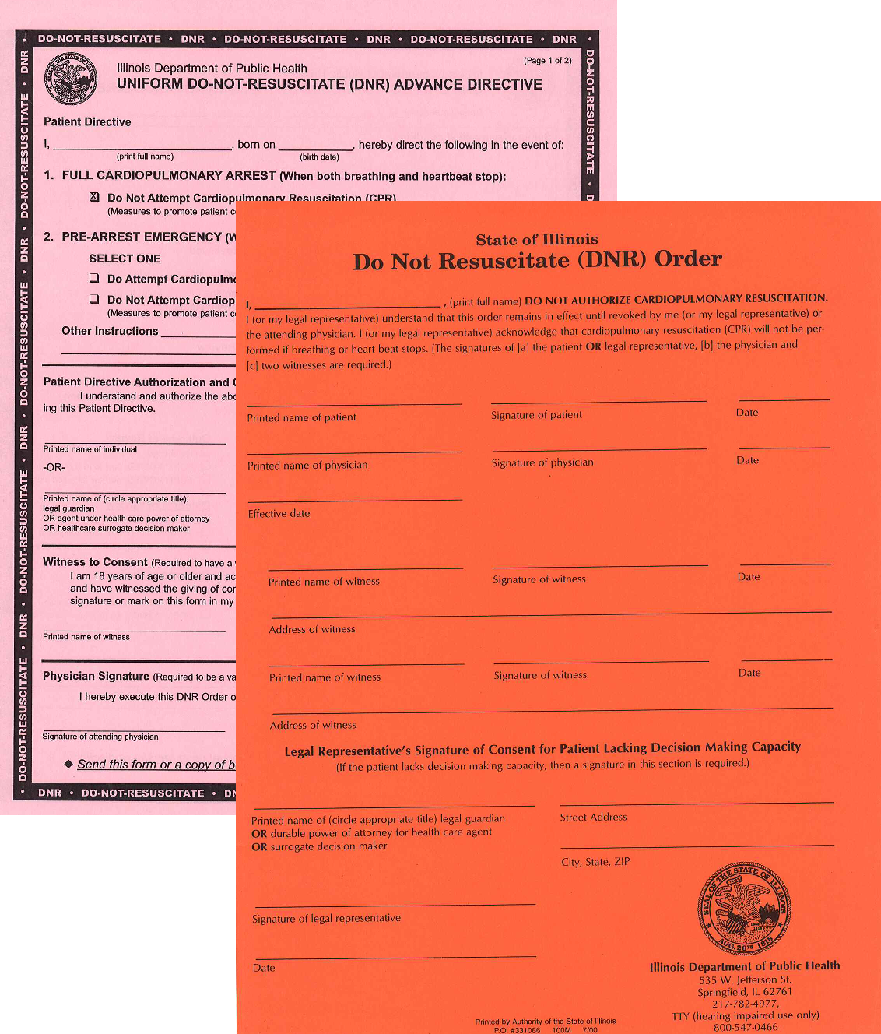
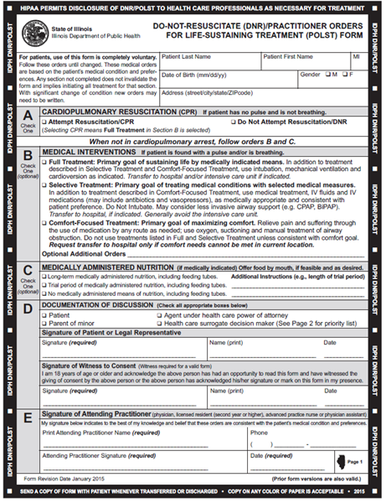
Various Forms Past & Present
Notes:
SUGGESTED SCRIPT:
You may encounter older forms in the field, and these are all VALID.
ASK THE GROUP:
In the field, have you seen forms other than the most current IDPH Uniform POLST such as older forms; out of state forms; the National form?
Have you questioned whether it is okay to honor any forms you have seen?

Slide 9
All Previous Version are Still Valid
Older versions of the Illinois form are still valid and should direct treatment.
A valid form does not expire and should be honored.
Form should always travel with patient and be readily accessible to healthcare professionals.
Notes:
ASK THE GROUP:
Do you have any questions on this topic?

Slide 10
Rely on Advance Directives (POLST) ONLY if Patient CANNOT Make Decisions
Patient
POLST
Directions (for physician)
Directions for Emergency Care
Power of Attorney for Health Care
Agent (rarely contains directions for physician)
Mental Health Treatment Declaration
Directions + Agent (for physician)
Living Will
Notes:
TO THE PRESENTER:
You can use this slide to help uncover what knowledge your audience already has.
SUPPLEMENTAL SCRIPT:
POLST is a medical order set, so it applies to all health care providers including EMS. Other advance directives give medical providers information about the patient’s treatment preferences and legally authorized decision maker but are not medical orders.
ASK THE GROUP:
What would you do if the person with the patient showed you their living will, but no POLST form was present/completed?
(EMS would provide all indicated treatment – living will does not direct care; living will should be brought to the hospital with the patient.)
What if the person with the patient says they are the POAHC but shows you no documentation and demands care that is different from what is recorded on a valid POLST form?
(Follow the POLST form.)
What if the patient is still decisional and has a POLST form present – what role does POLST play in this situation?
(The patient can speak on their own behalf and decide what treatment to have or not have; the POLST does not apply in this situation.)
What if the person with the patient claims the patient has a POLST that indicates DNR but cannot present it?
(EMS would provide all indicated treatment; once the POLST form is presented, then orders can be followed probably at the hospital)

Slide 11
Why does the POLST Form exist?
First responders need clear guidance for how to respond to a medical emergency in the field
Recognized IDPH standardized form for the entire state of Illinois
Concrete medical orders that must be followed by healthcare providers and first responders, so that treatment is in keeping with the person’s wishes
Evolved from the original IDPH DNR form (prior versions of forms are valid)
Notes:
SUGGESTED SCRIPT:
The POLST IL form is standardized and recognized throughout the state. The IL Department of Public Health is responsible for publishing and providing guidance on using the form.
***The POLST form is an immediately available, portable, out-of-hospital medical order set that assists emergency personnel in providing treatments aligned with patient preferences during an emergency.
ASK THE GROUP:
Do you have any questions on the last couple of slides?

Slide 12
Intended Use of POLST Form
The POLST decision-making process and resulting medical orders are intended for people of any age who are at risk for a life-threatening clinical event because they have a serious life-limiting medical condition, which may include advanced frailty.
COMPLETING FORM IS VOLUNTARY: Language added stressing that the form cannot be required of any patient and is completely voluntary
Pediatric patients with a valid POLST form should be treated the same as an adult.
Notes:
SUPPLEMENTAL SCRIPT:
Let’s say you have a 3-year-old patient with a faint heartbeat and no breathing. The parent presents a valid POLST form with DNR selected in section A and comfort-focused treatment in section B.
ASK THE GROUP:
Have you ever encountered a child with a POLST form?
What challenges does this scenario present for you, if any?
While not providing full treatment to a minor child may feel uncomfortable, first responders don’t know the history of the child and their underlying medical condition. It is important to understand the deep consideration and effort the parent/s has/have gone through in making the decisions recorded on the POLST form and honor those.

Slide 13
What are the benefits of POLST?
Promotes Person-Centered Care
Allows the person, loved ones and providers to discuss and document the person’s values and preferences for treatment in a medical emergency
Protects individuals who live in the community from treatment that is inconsistent with their preferences
Reduces medical errors by improving guidance during life-threatening emergencies
Notes:
TO THE PRESENTER:
Review slide as written

Slide 14
IDPH Uniform POLST: Form Explanation

Slide 15
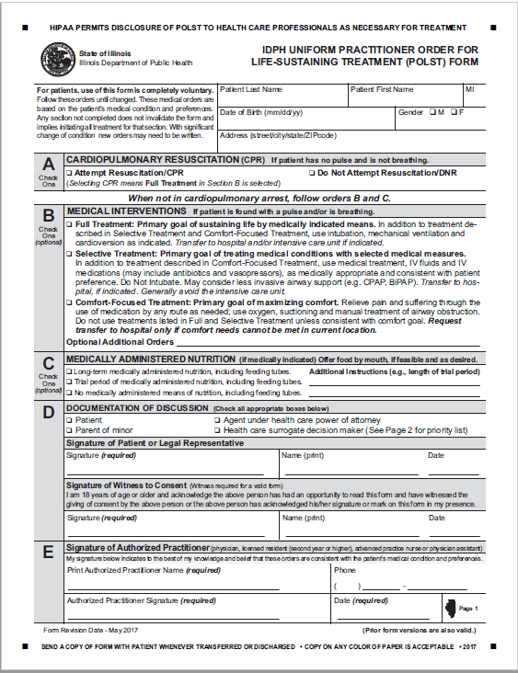
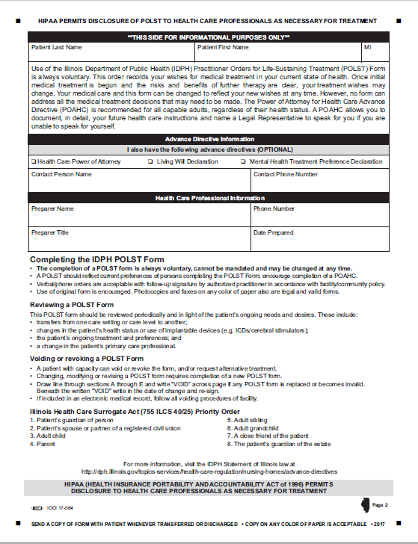
The IDPH Uniform POLST Form
Notes:
TO THE PRESENTER:
Please review the form’s general layout. Additional details on each section are broken down over the next few slides.
SUGGESTED SCRIPT
This is the current document, revised as of 2017
***It is important for healthcare professionals to read a completed form CAREFULLY. The mere existence of a form does not assume a person is DNR. This form allows someone to indicate they want CPR. If a form does not exist – then full treatment including CPR is the default. If the person wishes to have all life sustaining treatment/CPR, then they should seriously consider not completing a POLST form until their health status and/or preferences change.

Slide 16
3 Primary Medical Order Sections
If NO pulse and NO breathing: CPR wishes
Attempt resuscitation
Do Not Attempt resuscitation (DNR)
If pulse and/or breathing are present: Care wishes
Full Treatment
Selective Treatment
Comfort-Focused Treatment
Medically Administered Nutrition
Acceptable
Trial Period
None
Notes:
TO THE PRESENTER:
Review this slide as the general outline of decision categories in the IDPH POLST form. Do not go into detail here. Those are covered on the next several slides.

Slide 17
Section “A”: Cardio-Pulmonary Resuscitation
Section A documents what a person wishes to occur if they are found with no pulse and not breathing.
The presence of a POLST form DOES NOT mean DNR. Patients can use a POLST Form to indicate “Attempt Resuscitation” as well as “Do Not Attempt Resuscitation”.
If “Attempt Resuscitation/CPR” box checked: Start CPR and full cardiac arrest care per local protocol.
If “DNR” box checked: Do NOT begin CPR.
Notes:
REVIEW SLIDE IN FULL
SUGGESTED SCRIPT:
***SECTION A describes what the patient wishes to happen if they are found to have NO pulse and NOT breathing. In other words, death has occurred, and providers would need to attempt resuscitation for the patient to have a chance of surviving.
All other situations will be covered in another part of the form.
ASK THE GROUP:
Do you have any questions about section A?

Slide 18
Attempt CPR is the Default Why use the form to request CPR?
Elderly and those with disabilities may fear they will not receive same emergency care as others
May have created a POLST form marking DNR box during a serious illness. May create a new form if health improves or they desire to reach a milestone moment; now selecting attempt CPR

Slide 19
Acceptable Options for a Valid Form
Section A
Section B
Yes! Do CPR
Full Treatment
Full Treatment
DNR: No CPR
Selective Treatment
Comfort-Focused Treatment
Notes:
TO THE PRESENTER:
Please confirm that participants questions are answered on this issue. A person cannot choose “Attempt CPR” in section A and then choose “Do Not Intubate” in Section B.
SUGGESTED SCRIPT:
***A common mistake in completing the POLST form is when a practitioner and their patient selects Yes to CPR in Section A, but does not select Full Treatment in Section B.
This combination is NOT COMPATIBLE.
A person who wants all possible treatment if they have died (no pulse or heartbeat) would also want all possible treatment before they have died. In other words, a person would not want to WAIT until they had died to receive full treatment. That would not make sense.
Therefore, if “Yes to CPR” is selected in Section A, then “Full Treatment” must be provided in a prearrest senario. A person should choose “Attempt CPR” in section A and then choose “Do Not Intubate” in Section B.
If “DNR; No to CPR” is selected in Section A, then any choice can be selected in Section B.

Slide 20
Section “B”: Medical Interventions
Section B documents what a person wishes to occur if they are found with a pulse and/or breathing present but unable to communicate; cardiac arrest may occur shortly. a pulse and/or are breathing:
The checked box explains patient’s goal for treatment and specifies which treatments the patient wants to have and avoid.
Notes:
TO THE PRESENTER:
Review this slide to explain that section B applies to a different situation than section A and how each choice relates to the patient’s general goals of care.
SUGGESTED SCRIPT:
*** Section B applies in medical emergencies ASIDE FROM CARDIAC ARREST. “Do Not Resuscitate” does not mean do not treat.
These are situations when there is a heartbeat and breathing, but one, the other or both are deteriorating. These situations could lead to cardiac arrest if not responded to medically. The question in these circumstances is not whether the patient wants to be resuscitated, but rather what level of treatment or what medical interventions the patient wants—or does not want.
SECTION B: Medical Intervention allows for one of three options. Each with a different goal.
Full Treatment – where the primary goal is sustaining life by medically indicated means
Selective Treatment – where the goal is treating medical conditions with selective medical measures
Comfort-Focused Treatment – where the goal is maximizing the comfort of the patient (note that comfort is ALWAYS provided to living patients in addition to other selected treatment).
We will go into more specifics on the next few slide.

Slide 21
Section “B”: Medical Interventions
Full Treatment: Transfer me to the hospital and provide all appropriate treatment. I want to live as long as possible.
Must be selected when selecting CPR in section A
Either box may be marked in Section A
Notes:
SUGGESTED SCRIPT:
***Reiterate - It is very important to understand that Sections A & B are used in different situations, so DNR in Section A does not determine care when a person is critically ill but with a pulse and/or is breathing. In these medical emergencies, first responders will follow the orders in Section B.
SECTION B: Full Treatment - includes all medically indicated treatments for sustaining life including intubation, ventilation, cardioconversion, dialysis, surgery, etc. This will almost always mean transferring the patient to the hospital and providing care in the ICU if needed.
Here is an example -the same patient who chooses DNR in Section A, may also believe that if they are choking or having a severe asthma attack and are in need of an in-line neb or an advanced airway that would save their life and preserve their neurologic function, they may choose Full Treatment in Section B. In Section B, Full Treatment is not meant to also apply to cardiac arrest management.
Another example: let’s say someone has pneumonia and develops septic shock. They are willing to have all medical treatment aimed at reversing these processes. But given their severe, inoperable CAD, they understand that, should they have a cardiac arrest, even as a result of the sepsis, their prognosis for recovery significantly lowers. So they would like to try antibiotics, pressors, be in the ICU, on a vent if necessary, but would not want ACLS should their heart stop. That would be a situation where they would mark No CPR in section A and Full Treatment in Section B.
Please note, if a person chooses Attempt Resuscitation/CPR in section A, then the practitioner must mark – “Full Treatment” in Section B.
ASK THE GROUP:
Do you have any questions about Full Treatment in section B?

Slide 22
Section “B”: Medical Interventions
Selective Treatment: Transfer me to the hospital for medical treatment, but I do not want to be on the ventilator.
Person could receive treatments such as:
IV fluids; IV meds as appropriate
May use CPAP, BiPAP, BVM
Other treatments as needed to return to “baseline”
Notes:
SUGGESTED SCRIPT:
*** SECTION B: Selective Treatment – in general this means some or most indicated treatments will be provided to the patient except intubation/ventilation. For patients who choose this option, the goal is to avoid the ICU but attempt to return as much as possible to their baseline. It is especially important to note the specific treatments the patient wants and does not want if this option is chosen, for example – airway support, dialysis, major surgery, etc.
An example of using this option is a patient with heart failure having severe shortness of breath. They may want a trial period of CPAP/BiPAP but do not want to be intubated. This patient may be far more comfortable if we can provide noninvasive pressure support ventilations and/or position them appropriately to relieve their distress. King LTD, LMA, Combi tube are other examples of advanced airways that the patient generally intends to refuse if this box is marked.
CPAP and BiPap are only indicated if the patient has adequate respiratory effort. A BVM is used by rescue personnel if the patient requires assisted ventilations..
ASK THE GROUP:
Do you have any questions about Selective Treatment in section B?

Slide 23
Section “B”: Medical Interventions
Comfort-Focused Treatment: I want to be as comfortable as possible where I am but transfer me to the hospital if my pain or symptoms cannot be alleviated.
Notes:
SUGGESTED SCRIPT:
*** SECTION B: Comfort-Focused Treatment – this option is focused on relief of pain and other distressing symptoms rather than prolonging life. Interventions listed in Full and Selective Treatments will not be used if this option is selected. Transfer to a hospital should be avoided unless it is needed for symptom management.
A good example of this would be a hospice patient. “Please keep me out of pain but let me die at home.” One of the problems that EMS personnel face is being called to a home because the family does not know what to do when the patient deteriorates and end of life appears imminent. EMS responds and the family requests help, but they do not know what that help should be. EMS usually has to transport the patient even though patient’s wish is to not be transported. There is now a caveat written into the form states, “Transfer to hospital only if comfort needs cannot be met in current location.”
ASK THE GROUP:
Do you have any questions about Comfort-Focused Treatment in section B?

Slide 24
Section “B”: Medical Interventions
Optional Additional Orders - used to customize form for individual medical conditions when necessary
Notes:
SUGGESTED SCRIPT:
This is where the health care professional preparing the POLST form with the patient/substitute decision-maker can indicate specific treatments that should or should not be used and/or what circumstances should be considered in treatment decisions.
Make sure to look careful at these orders to see if any apply to EMS. Note that EMS can only provide interventions entered under “Additional Orders” if they are within their scope of practice. If these orders are questionable, contact on-line medical control for direction.
So when would this be used?
Comfort Measures patients – use of pain medications and antiemetics but no cardiac medications……
Limited Additional patients – no defibrillation, no oral or nasal airways, IV fluids for hydration only……
Intubation and Mechanical patients – trial of intubation and mechanical ventilations for X days only if able to be neurologically intact.
ASK THE GROUP:
Do you have any examples of what we may find in the optional additional orders.

Slide 25
Section “C”: Medically Administered Nutrition
Documents how nutrition should be administered
Always offer food by mouth if safe and desirable
This section does not typically apply to an emergency
Provides clear direction to avoid contested care
For patients with TPN/tube feedings needing transport, contact Medical Control
Notes:
SUGGESTED SCRIPT:
*** Section C applies only in situations when the patient cannot communicate with medical professionals and when a feeding tube is being considered and is medically indicated.
The patient can choose to
Have a feeding tube over the long-term
Have a feeding tube for a trial period (indicating goals for the trial period) or
Refuse a feeding tube in all circumstances

Slide 26
Section D: Documentation of Discussion
Need 2 signatures here
Patient, agent (POAHC), or healthcare surrogate
Witness to consent
If consented by patient’s legal representative, supporting documents verifying agent powers are NOT needed by EMS
Notes:
Anyone can witness the DNR/POLST form. The only restriction is that it cannot be the “Primary Care Giver”. The primary care giver is the practitioner that is directing the patient’s care. All other medical personnel are carrying out the practitioner’s orders so can witness the form if needed.
ASK THE GROUP:
Do you have any questions about section D?

Slide 27
Section E: Signature of Practitioner
Must have practitioner’s name, signature, and effective date to be valid. Verbal orders are allowable.
Practitioner’s signature may be written by a nurse who adds her/his own initials - acceptable and form is valid
Notes:
ASK THE GROUP:
Have you ever encountered a POLST form that is not signed? What are your thoughts about this?
Without a signature, it is not a valid form so you would handle it as though no POLST form was presented and provide all indicated treatment by default.

Slide 28
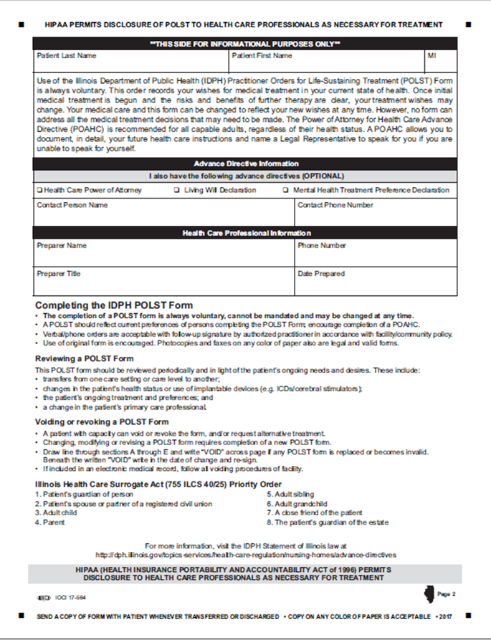
Back Page – EMS does not take action
Completing the back page of the POLST form is optional
Form is valid if only first page.
Information is helpful in identifying next of kin/emergency contact information.
Notes:
SUGGESTED SCRIPT:
The back page of the IDPH Uniform POLST Form is for informational purposes only.
***The form is valid even if left blank or not included.
This side is purely option. EMS personnel do not need to review or take action on any of these notations.
Phone numbers may be helpful to contact family, friend or others
ASK THE GROUP:
Do you have any questions about the POLST form that we have not covered?

Slide 29
Applying POLST Forms in the Field

Slide 30
Requirements for a Valid POLST Form
REQUIRED
Section A
3 Signatures:
1) Patient or legal substitute decision-maker 2) Witness 3) Practitioner
Patient Identifying Information
OPTIONAL
All other information optional
All indicated treatment used where a decision is unspecified
Pink paper recommended to enhance visibility, but color does not affect validity of form
Date of Practitioner Signature
Notes:
TO THE PRESENTER:
Cover all the bullets on the slide.
***SUPPLEMENTAL SCRIPT:
Pink paper is recognizable BUT does not scan well.
Verbal/phone orders from a practitioner are acceptable.

Slide 31
Valid POLST Forms
Properly executed prior versions of the IDPH Uniform DNR or the DNR/POLST Advance Directive are still valid. Most recently dated is followed.
Photocopies of forms are valid.
Picture of POLST form on electronic device is valid.
Notes:
TO THE PRESENTER:
Cover all the bullets on the slide.
Photocopies of a completed IDPH Uniform POLST Forms are valid. Originals are not necessary. A healthcare worker may presume in the absence of knowledge to the contrary that a POLST form with all the mandatory elements noted or a copy of that form is a valid.
ASK THE GROUP:
Have you ever encountered a form in the field that you were not sure was valid? What made you question its validity?
Each health care facility may have different policies on whether copies of DNR or POLST orders completed on a form other than an IDPH Uniform POLST Form are accepted as valid. It is advisable to check with a health care facility regarding its DNR or POLST policy.

Slide 32
What if 2 or more POLST forms are present?
Newest valid form voids past forms
Follow instructions on form with most recent date and all required elements
EMS is not responsible for investigating presence of other forms - consider form presented to be most current and valid.

Slide 33
Who can revoke POLST orders?
Patient, if competent to make decisions, can revoke a POLST at any time
Other situations more complicated and may take time to resolve
If any doubt or dispute, call OLMC
A POA/Surrogate should generally not overturn decisions made, documented, and signed by a patient
EMS responders are legally protected if they follow orders on a valid form in good faith
Notes:
SUPPLEMENTAL SCRIPT:
A POA or surrogate could very well argue that a patient who wanted “full treatment” before has now deteriorated to the point where s/he would only want “selective “or “comfort” measures. That change in status can usually be quickly approved by OLMC.
However, if a POA or surrogate wants to overturn a comfort-care order and escalate to Full Treatment OR change a DNR order consented to by the patient themselves when they were decisional, that decision must be carefully reviewed with OLMC. A POA/surrogate is supposed to act according to the patient wishes and not their own.
ASK THE GROUP:
Have any of you ever been asked to disregard a POLST order and do something else? Please describe what happened.

Slide 34
What if a POAHC or Surrogate disputes a valid POLST order to which they previously consented?
Determine if person disputing order is the original consenting POAHC or surrogate
If yes: The POAHC/surrogate may change the order and/or care wishes
If no: Follow orders on the POLST form; contact OLMC for further direction
Notes:
SUPPLEMENTAL SCRIPT:
This slide explains how EMS can deal with situations if there are disagreements in the field.
Bottom line ASK OLMC if you are in a gray area about a bystander overturning a POLST.

Slide 35
Legal Risk for EMS Following POLST Form
“A health care professional who in good faith complies with a do-not-resuscitate order made in accordance with this Act is not, as a result of that compliance, subject to any criminal or civil liability, except for willful and wanton misconduct, and may not be found to have committed an act of unprofessional conduct.”
Illinois Health Care Surrogate Act
Notes:
SUPPLEMENTAL SCRIPT:
***EMS is not responsible for investigating presence of other forms - consider form presented to be most current and valid.

Slide 36
QUESTION & ANSWER

Slide 37
Let’s Review

Slide 38
Check for understanding
An unconscious adult presents in bed at home. The patient is not breathing but does have a weak pulse. An IDPH POLST form is on the fridge. What part of the form is most relevant right now?
Section A: Has the patient marked DNR?
Section B: How aggressively does the patient want to be treated?
Section C: Has the patient consented to artificial nutrition?

Slide 39
Answer
Answer is B. Because the patient still has a pulse, section A does not apply now.
Section C discusses the placement of a feeding tube and is not immediately relevant here.

Slide 40
Check for understanding
You are called to an emergency in a person’s home and find a gentleman lying in his own bed. He is not breathing and has no pulse.
The neighbor has already started CPR. The IDPH POLST form is on the fridge. What instructions are you looking for?
Section A: has the patient marked DNR?
Section B: how aggressively does the patient want to be treated?
Section C: has the patient consented to artificial nutrition?

Slide 41
Answer
Answer is A. Patient is not breathing and does not have a pulse so sections B and C would not apply now.
If the neighbor is not a healthcare provider, they would not be expected to know about or follow the POLST form. If the neighbor has not restored breathing or a pulse, the EMS provider would still follow the POLST instructions under section A.

Slide 42
Check for understanding
A patient presents in cardiac arrest and his wife provides two forms, one earlier IDPH DNR Advance Directive/POLST form, dated 3/16/15 and one revised IDPH POLST form dated 3/27/ 2019. The options chosen on the two forms conflict. What should you do?
Provide the more aggressive treatment indicated, just in case.
Ask the patient’s wife to resolve the difference between the forms.
Provide the treatment indicated in the most recently dated POLST form.

Slide 43
Answer
Answer is C. Provide the treatment indicated in the most recently dated POLST form.
Newest valid form voids past forms. Follow instructions on form with most recent date and all required elements.

Slide 44
Check for understanding
An unconscious female presents on the floor at home. The patient is is having a seizure, is breathing and has a pulse. The patient’s husband shows you her IDPH Uniform POLST form where CPR is selected in Section A, and Comfort-Focused Care is selected in Section B. What should you do?
Provide Full Treatment as indicated and within your scope of practice.
Provide Comfort-Focused Treatment only.
Contacting OLMC for assistance before doing anything.

Slide 45
Answer
A person who has chosen CPR in Section A of IDPH Uniform POLST form will receive all medically indicated treatments in a pre-arrest emergency, i.e. Full Treatment in Section B, even if Comfort Care or Limited Additional Interventions are selected on the form.
It would not make sense to provide only comfort-focused treatment up until a person dies and then provide CPR.

Slide 46
POLST Resources
For POLST Illinois information:
polstIllinois@gmail.com
1-855-765-7845
www.polstil.org
National POLST Program
www.polst.org
Notes:
TO THE PRESENTER:
Review information on the slide and ask for final questions. Any outstanding issues can be communicated to IL POLST through the website.

Slide 47
This presentation created by the POLST Illinois Education Committee has been made possible by in-kind and other resources provided by:

Slide 48
Where did POLST come from?
Notes:
SUGGESTED SCRIPT:
***While the POLST IL is supported by a national program that assists states and provides quality standards, each state develops and administers its own POLST Program. In some states, the program is called POST, MOLST, MOST or something else.
The POLST model model started in Oregon which released the first POLST form in 1995.
After several years of evaluation, the program became known as Physician Orders for Life-Sustaining Treatment (POLST).
In 2004 the National POLST Advisory Panel was established, later known as the National POLST model Task Force.
POLST adoption gradually expanded state by state as a way to ensure patient preferences for end-of-life care are consistently honored.

Slide 49
Why would a person need a POLST form?
Helps ensure appropriate care and treatment if a person experiences an acute deterioration of their health
Helps share goals-of-care preferences and instructions amongst family caregivers or when transferring sites of care (e.g., nursing home, paramedics, hospital, home)
Allows loved-ones to contact 911 in a critical medical emergency without fear of patient receiving unwanted treatment if death is imminent
Notes:
TO THE PRESENTER:
Review slide as written

Slide 50
How is a POLST Form different from a Power of Attorney for Health Care?
 | POWER of ATTORNEY for HEALTH CARE | POLST Form
Who needs | All Decisional Adults | Serious Life-limiting Medical Condition
Who completes | Individual | Health Care Practitioner
Appoints a substitute decision maker | Yes | No
Real-time instructions for first responders | No | Yes
Notes:
TO THE PRESENTER:
Provide an overview of the table on the slide.
SUPPLEMENTAL SCRIPT:
***A decisional adult who is appropriate for POLST should have both a POLST form (actionable medical orders) and a Power of Attorney for Health Care form (appointed medical decision maker)
Who needs –
Adults of any age should be encouraged to complete a power of attorney for health care.
POLST is only for residents who are considered to be at risk for a life-threatening clinical event because they have a serious life-limiting medical condition, which may include advanced frailty.
Real-time instructions for first responders:
In an emergency, no matter what a person has written in an advance directive, first responders are most likely to follow the standard of care which is to do everything medically indicated to attempt to save the person’s life, including transportation to the hospital and administering any necessary life sustaining treatment.
But, when the person has POLST form, the orders on the form are followed by first responders, so that the person gets only the medical treatments they desire and not treatments they wish to avoid, including, if indicated, not being transported to the hospital unless necessary for control of pain and other symptoms.

Slide 51
Acceptable Options for a Valid Form
Section A
Section B
Yes! Do CPR
Full Treatment
Full Treatment
DNR: No CPR
Selective Treatment
Comfort-Focused Treatment
Notes:
TO THE PRESENTER:
Quickly recap the options for completing Section B and ask for questions

