Slide 1
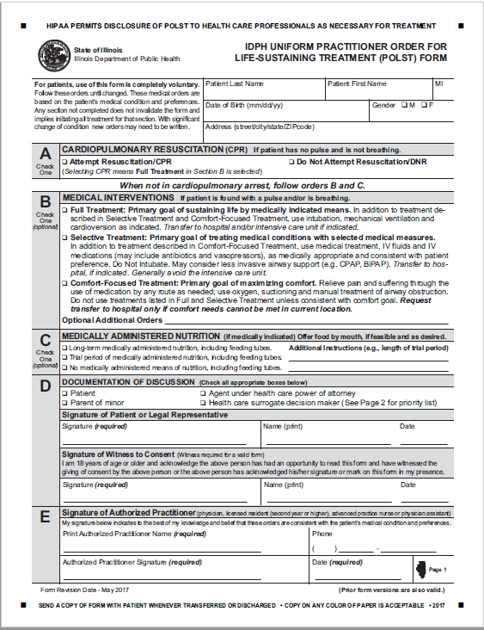
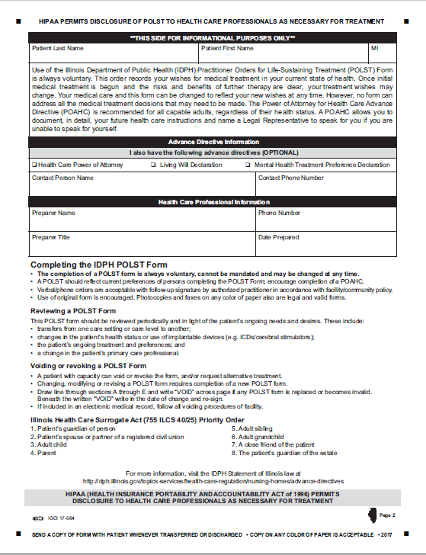
The IDPH Uniform POLST Form
Notes:
TO THE PRESENTER:
Please review the form’s general layout. Additional details on each section are broken down over the next few slides.
SUGGESTED SCRIPT
This is the current document, revised as of 2017
***It is important for healthcare professionals to read a completed form CAREFULLY. The mere existence of a form does not assume a person is DNR. This form allows someone to indicate they want CPR. If a form does not exist – then full treatment including CPR is the default. If the person wishes to have all life sustaining treatment/CPR, then they should seriously consider not completing a POLST form until their health status and/or preferences change.

Slide 2
Section “A”: Cardio-Pulmonary Resuscitation
Documents what a person wishes to occur if the are found with no pulse and not breathing.
The presence of a POLST form DOES NOT mean DNR. Patients can use a POLST Form to indicate “Attempt Resuscitation” as well as “Do Not Attempt Resuscitation”
If “Attempt Resuscitation/CPR” box checked: Start CPR and full cardiac arrest care per local protocol
If “DNR” box checked: Do NOT begin CPR
Notes:
SUGGESTED SCRIPT:
***SECTION A describes what the patient wishes to happen if they are found to have NO pulse and NOT breathing. In other words, death has essentially occurred, and providers would need to attempt resuscitation for the patient to have a chance of surviving. The patient or decision maker should be clear that this section only comes into play when the patient has essentially died. All other situations will be covered in another part of the form.
NOTES FOR COACHING A POLST CONVERSATION:
If appropriate to the audience, suggest/discuss ways to explain section A to patients/decision maker:
This section of the form allows you to document what you/the patient will want if your/the patient’s heart completely stops, you/the patient are/is not breathing and have/has in effect, died a natural death. In that situation, a medical procedure called Cardiopulmonary Resuscitation (CPR) can be tried to restart your/the patient’s heart. Unfortunately, CPR is not as successful as most people think, especially for people who are weaker and sicker. In this situation, CPR works a small amount of the time. If your/the patient’s heart is restarted by CPR, it normally requires being in the Intensive Care Unit. There is also the possibility that CPR may cause serious side effects, and it will not cure the original medical problem.
Do you have any questions?
If CPR is desired – Mark “Attempt Resuscitation/CPR” in section A. Go to section B.
If DNR is desired – Mark “Do Not Attempt Resuscitation/DNR” in section A. Go to section B.

Slide 3
Section “B”: Medical Interventions
Documents what a person wishes to occur if they are found with a pulse and/or breathing but unable to communicate; cardiac arrest may occur shortly. a pulse and/or are breathing:
Explains patient’s goals for treatment and specifies which
treatments the patient wants to have and avoid.
Notes:
SUGGESTED SCRIPT:
*** Section B applies in medical emergencies ASIDE FROM CARDIAC ARREST. These are situations when there is a heartbeat and breathing, but one, the other or both are deteriorating. These situations could lead to cardiac arrest if not responded to medically. The question in these circumstances is not whether the patient wants to be resuscitated, but rather what level of treatment or what medical interventions the patient wants—or does not want.
We will go into more specifics on the next slide.
NOTES FOR COACHING A POLST CONVERSATION:
If appropriate to the audience, suggest/discuss ways to introduce section B to patients/decision makers:
In a situation when you/the patient are/is critically ill and not able to communicate, but you/patient have/has a pulse or are breathing, then medical professionals would look at Section B on a POLST form.
Section B is very important—it is the heart of POLST.
People who want to be DNR in Section A, choose all different options in Section B, so we need to discuss what you/the patient would want in this situation.

Slide 4
Section “B”: Medical Interventions
Full Treatment: Provide all care per protocol; transport if indicated
Either box may be marked in Section A , which is for full cardiac arrest. “Full Treatment” in Section B applies to non-cardiac arrest emergencies.
If CPR is indicated in Section A, then “Full Treatment” MUST be checked in Section B.
Notes:
SUGGESTED SCRIPT:
***Reiterate - It is very important to understand that Sections A & B are used in different situations, so DNR in Section A does not determine care when a person is critically ill but with a pulse and/or is breathing. In these medical emergencies, first responders will follow the orders in Section B.
SECTION B: Full Treatment - includes all medically indicated treatments for sustaining life including intubation, ventilation, cardioconversion, dialysis, surgery, etc. This will almost always mean transferring the patient to the hospital and providing care in the ICU if needed.
Here is an example -the same patient who chooses DNR in Section A, may also believe that if they are choking or having a severe asthma attack and are in need of an in-line neb or an advanced airway that would save their life and preserve their neurologic function, they may choose Full Treatment in Section B. In Section B, Full Treatment is not meant to also apply to cardiac arrest management.
Another example: let’s say someone has pneumonia and develops septic shock. They are willing to have all medical treatment aimed at reversing these processes. But given their severe, inoperable CAD, they understand that, should they have a cardiac arrest, even as a result of the sepsis, their prognosis for recovery significantly lowers. So they would like to try antibiotics, pressors, be in the ICU, on a vent if necessary, but would not want ACLS should their heart stop. That would be a situation where they would mark No CPR in section A and Full Treatment in Section B.
Please note, if a person chooses Attempt Resuscitation/CPR in section A, then the practitioner must mark – “Full Treatment” in Section B. To understand this, think about a person close to death who want CPR, you would not wait until after they died to try to save their life – you would give them all indicated treatments right away.
Do you have any questions?
NOTES FOR COACHING A POLST CONVERSATION:
If appropriate to the audience, suggest/discuss ways to explain “Full Treatment” w/ patients/decision makers:
If yes to CPR in Section A –
Since you have chosen to have emergency medical professionals attempt to resuscitate you/the patient by giving CPR when there is no pulse or breathing, then it follows that you also want full treatment if your/the patient’s heart has not stopped beating, no matter how critical your/the patient’s condition. Does this make sense?
If CPR did get your heart beating again, it is nearly guaranteed that you will be in the ICU on a ventilator for at least a short while. After that, if you did not show improvement and your doctor thought your chances of getting better were poor, would you still want to be kept alive on the ventilator?
If Yes – Mark “Full Treatment” in section B. Go to section C.
If No – Ask:
If your doctor does not think you/the patient are/is going to make a good recovery, we can write in Additional Orders – “Trial period to meet my goals. Does that make sense?
Mark “Full Treatment” in Section B and complete the optional additional orders section.
If NO CPR in Section A:
It is important to understand each person’s goals and wishes to determine the best option in section B.
As your/the patient’s illness progresses, it is possible you/the patient may have critical health problems. If you/the patient got so sick that you/the patient were struggling to breathe, you/the patients might need to be put on a ventilator, which is a machine that will helps the lungs. The ventilator is not comfortable and will prevent you/the patient from communicating with people. Also, you/the patient would need to be in the intensive care unit of the hospital.
If you/the patient were that sick, would you/they want to go to the hospital and be placed on the ventilator?
If YES to Ventilator in Sec. B: Mark - Full Treatment, and continue:
If you/the patient are/is on the ventilator and not improving, and the doctor thinks your/their chances of getting better are very small, would you/the patient want to be kept alive on the ventilator for long time?
IF YES – do nothing else in section B. Go to section C.
IF NO – Add:
If your doctor does not think you are going to make a good recovery, we can write in Additional Orders – “Trial period to meet your goals. Does that make sense?
Complete the optional additional orders section.

Slide 5
Section “B”: Medical Interventions
Selective Treatment: Comfort-focused treatment plus basic medical interventions
IV fluids; IV meds as appropriate
Do NOT intubate: May use CPAP, BiPAP, BVM
Transport to hospital if indicated
Notes:
SUGGESTED SCRIPT:
*** SECTION B: Selective Treatment – in general this means some or most indicated treatments will be provided to the patient except intubation/ventilation. For patients who choose this option, the goal is to avoid the ICU but attempt to return as much as possible to their baseline. It is especially important to note the specific treatments the patient wants and does not want if this option is chosen, for example – airway support, dialysis, major surgery, etc.
An example of using this option is a patient with heart failure having severe shortness of breath. They may want a trial period of CPAP/BiPAP (IF INDICATED) but do not want to be intubated. This patient may be far more comfortable if we can provide noninvasive pressure support ventilations and/or position them appropriately to relieve their distress. King LTD, LMA, Combi tube are other examples of advanced airways that the patient generally intends to refuse if this box is marked.
Do you have any questions?
NOTES FOR COACHING A POLST CONVERSATION:
If appropriate to the audience, suggest/discuss ways to explain “Selective Treatment” in section B w/ patients/decision makers:
If NO to ventilator in Sec. B:
I understand you/the patient would not want to be put on a ventilator.
Some people still wish to go to the hospital for certain treatments if they will be able to recover and have a quality of life that is acceptable to them.
Other people reach a point when they would prefer not to go back to the hospital. They would prefer to stay home.
Tell me how you feel about your/the patient’s current quality of life and what kinds of treatment you/the patient would be willing to go through.
Determine if the person wants the types of medical treatments described in the “Selective Treatment” section. Explain these treatments as needed giving the person information about each treatment’s possible benefits and drawbacks. Use “optional Additional Orders” to indicate specific treatments the patient wishes to have or avoid and if a trial period is requested.
Mark - Selective Treatment: for persons wishing to be hospitalized (may include medical treatments including IV fluids and IV medications, and/or less invasive airway support) Specify any treatments to avoid in “Optional Additional Orders.”
Mark- Comfort-Focused Treatment: for persons wishing to stay at home and be kept comfortable without significant medical treatments.

Slide 6
Section “B”: Medical Interventions
Comfort Focused Treatment
Treat pain (per routes allowed by scope of practice), O2, suction; manual airway obstruction maneuvers
No transport unless comfort needs cannot be met in current location
Notes:
SUGGESTED SCRIPT:
*** SECTION B: Comfort-Focused Treatment – this option is focused on relief of pain and other distressing symptoms rather than prolonging life. Interventions listed in Full and Selective Treatments will not be used if this option is selected. Transfer to a hospital should be avoided unless it is needed for symptom management.
A good example of this would be a hospice patient. “Please keep me out of pain but let me die at home.” One of the problems that EMS personnel face is being called to a home because the family does not know what to do when the patient deteriorates and end of life appears imminent. EMS responds and the family requests help, but they do not know what that help should be. EMS usually has to transport the patient even though patient’s wish is to not be transported. There is now a caveat written into the form states, “Transfer to hospital only if comfort needs cannot be met in current location.”
Any questions
NOTES FOR COACHING A POLST CONVERSATION:
If appropriate to the audience, suggest/discuss ways to explain “comfort-focused treatment” to patients/decision makers and provide examples of what comfort care looks like in different clinical situations.
“Comfort-focused treatment” does not mean that you/patient will go without care. – for example:
If you/patient fell and broke a bone – you/the patient would be conscious so your POLST from would not be used to determine what kind of care to give. You would go the hospital to have the bone fixed in this case.
If you/patient were choking, you/they will not be left choking, they will be treated to eliminate the blocked airway.
Any condition that makes you/patient uncomfortable will be addressed to make you/patient as comfortable as possible. This may even mean going to the hospital if necessary, to relieve suffering.

Slide 7
Section “B”: Medical Interventions
Optional Additional Orders - used to customize form for individual medical conditions when necessary
Notes:
SUGGESTED SCRIPT:
This is where the health care professional preparing the POLST form with the patient/substitute decision-maker can indicate specific treatments that should or should not be used and/or what circumstances should be considered in treatment decisions.

Slide 8
Section “C”: Medically Administered Nutrition
Documents how nutrition should be administered
Always offer food by mouth if safe and desirable
Add information re specific circumstances or trial
Notes:
SUGGESTED SCRIPT:
*** Section C applies only in situations when the patient cannot communicate with medical professionals and when a feeding tube is being considered and is medically indicated.
Medically administered nutrition represents a considerable change in the patient’s way of life, so this section allows for a medical professional to discuss the patient’s goals of care and willingness to accept a feeding tube prior to a medical event that would necessitate this treatment.
The patient can choose to
Have a feeding tube over the long-term
Have a feeding tube for a trial period (indicating goals for the trial period) or
Refuse a feeding tube in all circumstances

Slide 9
Section D: Documentation of Discussion
Need 2 signatures here
Patient, agent (POAHC), or healthcare surrogate
Witness to consent
If consented by patient’s legal representative, supporting documents verifying agent powers are NOT needed by EMS
Notes:
Anyone can witness the DNR/POLST form. The only restriction is that it cannot be the “Primary Care Giver”. The primary care giver is the practitioner that is directing the patient’s care. All other medical personnel are carrying out the practitioner’s orders so can witness the form if needed.

Slide 10
Section E: Signature of Practitioner
Must have practitioner’s name, signature, and effective date to be valid. Verbal orders are allowable.
Practitioner’s signature may be written by a nurse who adds her/his own initials - acceptable and form is valid

Slide 11
Back Page - Guidance
Completing the back page of the POLST form is optional.
Form is valid if only first page.
Information on this page is very helpful to clinicians.
Notes:
SUGGESTED SCRIPT:
The back page of the IDPH Uniform POLST Form is for informational purposes only. ***The form is valid even if left blank or not included.
Fields on the back page include:
patient’s name
information about the existence of the patient’s advance directives
identity of the person who conducted the POLST conversation and prepared the form with the patient or substitute decision maker
Guidance at the bottom of the back page includes information about:
Completing a POLST Form
Reviewing a POLST Form periodically after completion
Revoking or voiding a POLST Form
The IL Health Care Surrogate Act order of priority for decision makers

