Slide 1

Hospital Setting – Form Signing / Practitioner Audience
Notes:
TO THE PRESENTER:
The content in these notes may be long for some slides. We’ve done this in order to provide as much information as possible to the presenter so that even if you are not as familiar with the POLST Paradigm you will have access to adequate explanations for important aspects of POLST.
Be sure to always present all the information on every slide. If you do not believe a slide is appropriate for your audience, you may hide it.
Look for *** to identify issues that, in our experience, are particularly challenging for clinicians to master; we recommend including the notes that are marked in this way in your spoken comments throughout your presentation.
Look for “SUGGESTED SCRIPT” where we provide ideas for what to say when presenting that slide.
Look for “SUPPLEMENTAL SCRIPT” where we provide ideas for what to say in addition to what it show on the slide.
Be sure to always present all the information on every slide. If you do not believe a slide is appropriate for your audience, you may hide it.

Slide 2
Permission to Use
This slide presentation may be used without permission. To promote consistency across the state, the slides may not be altered.
You may freely take language (but not screenshots) from this presentation to use in your own presentations.
Please send requests for institutionally specific modifications to polstIllinois@gmail.com.
Notes:
TO THE PRESENTER:
The POLST Illinois slide sets that are available on the website are locked so that we can maintain consistency of POLST IL-approved presentations. However, if you would like to create your own presentation you are welcome to reproduce contents of the slides; in that case, please do NOT use screenshots nor the official POLST logos.
These slides were created and are maintained by a generous group of volunteers across the state. Thank-you for your consideration.

Slide 3
Disclaimer
Note that this presentation provides clinical guidance for the POLST Paradigm and should NOT be construed as medical nor legal advice.
For answers to legal questions, check with your own legal counsel.
Notes:
TO THE PRESENTER:
***Please read the slide verbatim

Slide 4
Objectives
By the end of this session, participants will be able to:
Understand the POLST Model and when it is an appropriate part of advanced care planning
Describe the relationship between Advance Directives and POLST forms, and when each is appropriate for completion
Describe the elements of a quality POLST conversation
Understand the sections of the POLST form
Recognize the importance of care providers being properly educated regarding POLST Model policy and practice
Notes:
TO THE PRESENTER:
In our experience, many clinicians, including first responders, hospice staff and nursing home staff, have misunderstandings about the use of the POLST form. We have discovered many intelligent and competent clinicians who misunderstand some of the basic POLST information, and who “don’t know what they don’t know”. We believe that this presentation will help people recognize and fill-in the gaps in their POLST knowledge base.
You will also find useful information on the POLST Illinois website in the form of the Guidance Document and FAQ Document.
Lastly, you may wish to air this 8 minute national POLST overview video (www.youtube.com/watch?v=zlqQgCBChn0#t=118) as a part of or in preparation for your presentation. A link is embedded in the first bullet point of this slide.

Slide 5
POLST Program Overview

Slide 6
What is POLST?
In Illinois - POLST stands for Practitioner* Orders for Life Sustaining Treatment
It is NOT just a form, it is a process
  Approach to end-of-life planning based on thoughtful conversations with the person, a friend or family if desired, and healthcare professionals
  Incorporates values, beliefs and priorities as these relate to prognosis, likely disease course & treatment choices
  * Physician, Advanced Practice Registered Nurse, Physician Assistant, Resident in 2nd year or higher of residency program
Advance Practice Registered Nurse
Physician Assistant
Resident in 2nd year or higher of residency program
Notes:
SUGGESTED SCRIPT:
POLST is a process that helps identify a patient’s wishes regarding medical treatment through conversation, after which the patient’s treatment wishes are documented as a portable medical order, called a POLST Form.
***In IL, the POLST form can be signed either by a physician, an APN, PA or medical resident who has completed 1 year in an endorsed residency program.
***The POLST form is the most visible part, but the process behind its completion is the most important part. The conversation between the patient and his/her health care professional should include the patient’s goals of care considering current diagnosis, prognosis, and treatment options (including risks and benefits of each). The result of the conversation may be the completion of a POLST form—or it may be a first step in the care planning process.

Slide 7
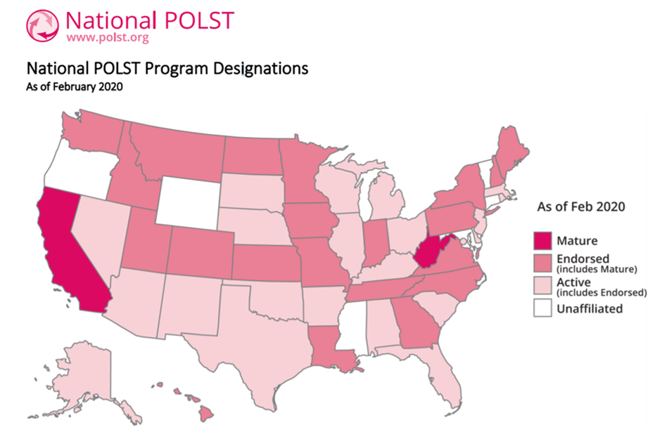
Where did POLST come from?
Notes:
SUGGESTED SCRIPT:
***While the POLST IL is supported by a national program that assists states and provides quality standards, each state develops and administers its own POLST Program. In some states, the program is called POST, MOLST, MOST or something else.
The POLST Paradigm model started in Oregon which released the first POLST form in 1995.
After several years of evaluation, the program became known as Physician Orders for Life-Sustaining Treatment (POLST).
In 2004 the National POLST Advisory Panel was established, later known as the National POLST Paradigm Task Force.
POLST adoption gradually expanded state by state as a way to ensure patient preferences for end-of-life care are consistently honored.

Slide 8
Why would a person need a POLST form?
Helps ensure appropriate care and treatment if a person experiences an acute deterioration of their health
Helps share goals-of-care preferences and instructions amongst family caregivers or when transferring sites of care (e.g., nursing home, paramedics, hospital, home)
Allows loved ones to contact 911 in a critical medical emergency without fear of patient receiving unwanted treatment if death is imminent
Notes:
TO THE PRESENTER:
Review slide as written

Slide 9
Why does the POLST Form exist?
First responders need clear guidance for how to respond to a medical emergency in the field
Recognized IDPH standardized form for the entire state of Illinois
Concrete medical orders that must be followed by healthcare providers and first responders, so that treatment is in keeping with the person’s wishes
Evolved from the original IDPH DNR form (prior versions of forms are valid)
Notes:
SUGGESTED SCRIPT:
The POLST IL form is standardized and recognized throughout the state. The IL Department of Public Health is responsible for publishing and providing guidance on using the form.
***The POLST form is an immediately available, portable, out-of-hospital medical order set that assists emergency personnel in providing treatments aligned with patient preferences during an emergency.

Slide 10
Who should have a POLST Form?
The POLST decision-making process and resulting medical orders are intended for people of any age who are at risk for a life-threatening clinical event because they have a serious life-limiting medical condition, which may include advanced frailty.
This includes but is not limited to people with:
  Severe Heart Disease
  Metastatic Cancer or Malignant Brain Tumor
  Advanced Lung, Renal or Liver Disease
  Advanced Frailty
  Advanced Neurodegenerative Disease
  (e.g., Dementia, Parkinson’s Disease, ALS)
Notes:
SUGGESTED SCRIPT:
***The POLST decision-making process and resulting medical orders are intended for patients who are considered to be at risk for a life-threatening clinical event because they have a serious life-limiting medical condition, which may include advanced frailty.
In order to assess whether a POLST conversation is appropriate for a person, clinicians should ask themselves “Would I be surprised if this person died within the next year?” If the answer is “No, I would not be surprised” then a POLST conversation, possibly resulting in completion of a POLST form, is appropriate.
***These persons include those with advanced illness and the frail elderly (including many persons in nursing homes who are there for custodial, not rehabilitative, care).
TO PRESENTER:
Patients with serious life-limiting medical condition or advanced frailty:
whose health care professional would not be surprised if they died within 1-2 years; or
who are at an increased risk of experiencing a medical emergency based on their current medical condition and who wish to make clear their treatment preferences, including about CPR, mechanical ventilation, ICU; or
who have had multiple unplanned hospital admissions in the last 12 months, typically coupled with increasing frailty, decreasing function, and/or progressive weight loss.

Slide 11
What else to know about a POLST?
Most people over age 65 are too healthy to have POLST orders.
POLST is not intended for people with chronic, stable disability, who must not be mistaken for being at the end of life.
The POLST form speaks for patients ONLY when they can’t speak for themselves.
The patient can void or change their POLST form at anytime as their disease and health changes.
A patient without POLST orders receives FULL TREATMENT as the default, and this may be a reason not to complete the form.
Accompanies patient from care setting to care setting
Notes:
SUGGESTED SCRIPT:
Most 65-year-olds are too healthy to have POLST orders.
***POLST is not intended for people with chronic, stable disability, who should not be mistaken for being at the end of life. POLST would only be appropriate for people with chronic disabilities if the person’s health deteriorates such that death within a year would not be unexpected.
The form is only used when the patient is unable to communicate for themselves.

Slide 12
How is a POLST Form different from a Power of Attorney for Health Care?
 | POWER of ATTORNEY for HEALTH CARE | POLST Form
Who needs | All Decisional Adults | Serious Life-limiting Medical Condition
Who completes | Individual | Health Care Practitioner
Appoints a substitute decision maker | Yes | No
Real-time instructions for first responders | No | Yes
Notes:
TO THE PRESENTER:
Provide an overview of the table on the slide.
SUPPLEMENTAL SCRIPT:
***A decisional adult who is appropriate for POLST should have both a POLST form (actionable medical orders) and a Power of Attorney for Health Care form (appointed medical decision maker)
Who needs –
Adults of any age should be encouraged to complete a power of attorney for health care.
POLST is only for patients who are considered to be at risk for a life-threatening clinical event because they have a serious life-limiting medical condition, which may include advanced frailty.
Real-time instructions for first responders:
In an emergency, no matter what a person has written in an advance directive, first responders are most likely to follow the standard of care which is to do everything medically indicated to attempt to save the person’s life, including transportation to the hospital and administering any necessary life sustaining treatment.
But, when the person has POLST form, the orders on the form are followed by first responders, so that the person gets only the medical treatments they desire and not treatments they wish to avoid, including, if indicated, not being transported to the hospital unless necessary for control of pain and other symptoms.

Slide 13
What are the benefits of POLST?
Promotes Person-Centered Care
Allows the person, loved ones and providers to discuss and document the person’s values and preferences for treatment in a medical emergency
Protects individuals who live in the community from treatment that is inconsistent with their preferences
Reduces medical errors by improving guidance during life-threatening emergencies
Notes:
TO THE PRESENTER:
Review slide as written

Slide 14
IDPH Uniform POLST:
I. The Conversation

Slide 15
Introducing the POLST Conversation
WHO:
Physician
APRN
PA
RN
Social Worker
Chaplain
Qualified healthcare practitioner reviews orders & signs form
WHAT TO DO:
Use simple language
Start with a DISCUSSION, then end with the POLST form itself
Explain under what circumstances the form might be useful
Ensure that the individual has necessary information to make each decision
Inform that POLST form is optional and can be changed at any time
Notes:
SUPPLEMENTAL SCRIPT:
The person who discusses the POLST model with the client/patient does not have to be the signing practitioner. Other members of the interdisciplinary team who are appropriately prepared with the knowledge base and communication skills can have the conversation, but the person who signs the form must be the client/patient’s attending practitioner (doctor, APN, PA, non-intern patient)
It is important to lay out different potential circumstances when the POLST might be used.
Since the POLST form has medical terms not all people understand, it is important that health care professionals share information about treatment options utilizing language and tools (e.g., videos or visuals) that help client/patients and families grasp the impact of their decisions. Then, it is the task of the health care professional to translate the individual’s goals of care, priorities, and wishes into medical orders using the language of medical professionals. Individuals should also be told that they can void and change the POLST form in the future if things change.
NOTES FOR COACHING A POLST CONVERSATION:
If appropriate to the audience, you can suggest/discuss ways to set-up the discussion with client/patients/families:
POLST is not for everybody, we are discussing it with you because…
It’s important that we know ahead of time, what your wishes are if you get really sick and there is a medical emergency where you cannot talk for yourself.
The POLST form documents in writing your wishes for your care in critical medical situations.
I want to make sure you have the knowledge to make decisions based on your current health issues.
Once the form is signed by the individual and practitioner, the form becomes a medical order. This requires all other healthcare professionals to follow the orders.
If at any time your medical situation changes, or if your wishes change, your POLST form can be changed.

Slide 16
POLST Conversation – BEFORE the Form
Review relevant medical facts; uncovering gaps in person’s understanding of prognosis
Explore experiences; identifying fears and concerns
  Awareness of potential complications resulting from illness
  Awareness of potential emergency treatments of these complications (e.g., CPR, intubation, hospitalization in ICU)
Ask patient to reflect on goals/values and how they influence preferences
And then, put the preferences in writing to translate them into actionable medical order
Notes:
TO THE PRESENTER
***To begin, the patient or their substitute decision maker and the healthcare provider discuss the patient’s goals of care considering his/her current diagnosis, prognosis, values around quality of life, concerns about the future and treatment options (including risks and benefits of each).
SUPPLEMENTAL SCRIPT
Review the medical facts around the patient’s current health.
The goal is to understand what the patient/SDM knows.
If their understanding is not consistent with their prognosis, alert the appropriate practitioner, so they can clarify.
2. Explore the patient’s/SDM’s experiences regarding serious illness.
Awareness complications that might occur
Awareness of how successful emergency treatments are and what complications are likely
3. Ask about
What patient values most
What concerns they have about the future
What goals of they have around quality of life

Slide 17
GAPS in Patient/Proxy Understanding
Medical practitioners may expect a referral back from the healthcare professional preparing the POLST form when the following gaps are uncovered:
  Diagnosis/prognosis not understood
  Family member/s and patient/proxy not on the same page
  Risks & benefits of POLST treatment options not understood
  Patient/proxy wishes are significantly different than anticipated
  Other substantial conflicts arise during the POLST conversation
Only the medical practitioner should provide clinical information about the patient to fill in knowledge gaps.
Notes:
TO THE PRESENTER
SUPPLEMENTAL SCRIPT

Slide 18
Demonstrating That You Care
Always approach with compassion
Ask for permission to proceed with difficult discussions
Encourage understanding between patients and family members
  Hearing the information for the first time is hard.
  It’s normal to need time to think things through.
  Use multiple conversations as needed.

Slide 19
IDPH Uniform POLST:
II. The Form

Slide 20
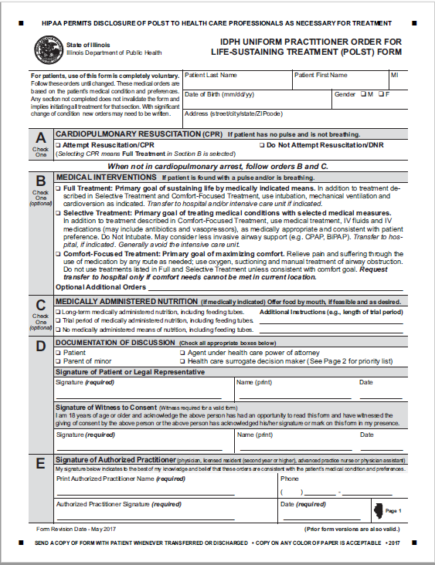
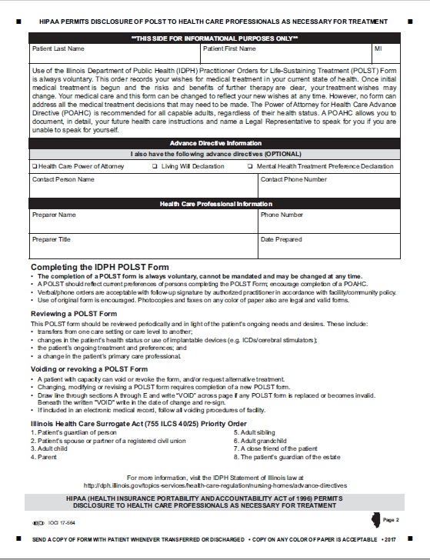
The IDPH Uniform POLST Form
Notes:
TO THE PRESENTER:
Please review the form’s general layout. Additional details on each section are broken down over the next few slides.
SUGGESTED SCRIPT
This is the current document, revised as of 2017
***It is important for healthcare professionals to read a completed form CAREFULLY. The mere existence of a form does not assume a person is DNR. This form allows someone to indicate they want CPR. If a form does not exist – then full treatment including CPR is the default. If the person wishes to have all life sustaining treatment/CPR, then they should seriously consider not completing a POLST form until their health status and/or preferences change.

Slide 21
3 Primary Medical Order Sections
If NO pulse and NO breathing: CPR wishes
  Attempt resuscitation
  Do Not Attempt resuscitation (DNR)
If pulse and/or breathing are present: Care wishes
  Full Treatment
  Selective Treatment
  Comfort-Focused Treatment
Medically Administered Nutrition
  Acceptable
  Trial Period
  None
Notes:
TO THE PRESENTER:
Review this slide as the general outline of decision categories in the IDPH POLST form

Slide 22
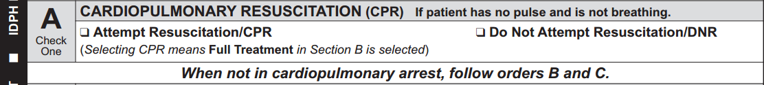

Section “A”: Cardio-Pulmonary Resuscitation
Section A documents what a person wishes to occur if they are found with no pulse and not breathing.
The presence of a POLST form DOES NOT mean DNR. Patients can use a POLST Form to indicate “Attempt Resuscitation” as well as “Do Not Attempt Resuscitation”.
If “Attempt Resuscitation/CPR” box checked: Start CPR and full cardiac arrest care per local protocol.
If “DNR” box checked: Do NOT begin CPR.
Notes:
SUGGESTED SCRIPT:
***SECTION A describes what the patient wishes to happen if they are found to have NO pulse and NOT breathing. In other words, death has essentially occurred, and providers would need to attempt resuscitation for the patient to have a chance of surviving. The person should be clear that this section only comes into play when the patient has essentially died. All other situations will be covered in another part of the form.
NOTES FOR COACHING A POLST CONVERSATION:
If appropriate to the audience, suggest/discuss ways to explain section A:
This section of the form allows you to document what you/the patient will want if your/the patient’s heart completely stops, you/the patient are/is not breathing and have/has in effect, died a natural death. In that situation, a medical procedure called Cardiopulmonary Resuscitation (CPR) can be tried to restart your/the patient’s heart. Unfortunately, CPR is not as successful as most people think, especially for people who are weaker and sicker. In this situation, CPR works a small amount of the time. If your/the patient’s heart is restarted by CPR, it normally requires being in the Intensive Care Unit. There is also the possibility that CPR may cause serious side effects, and it will not cure the original medical problem.
Do you have any questions?
If CPR is desired – Mark “Attempt Resuscitation/CPR” in section A. Go to section B.
If DNR is desired – Mark “Do Not Attempt Resuscitation/DNR” in section A. Go to section B.

Slide 23
Acceptable Options for a Valid Form
Section A
Section B
Yes! Do CPR
Full Treatment
Full Treatment
DNR: No CPR
Selective Treatment
Comfort-Focused Treatment
Notes:
TO THE PRESENTER:
Please confirm that participants questions are answered on this issue. A person cannot choose “Attempt CPR” in section A and then choose “Do Not Intubate” in Section B.
SUGGESTED SCRIPT:
***A common mistake in completing the POLST form is when a practitioner and their patient selects Yes to CPR in Section A, but does not select Full Treatment in Section B.
This combination is NOT COMPATIBLE.
A person who wants all possible treatment if they have died (no pulse or heartbeat) would also want all possible treatment before they have died. In other words, a person would not want to WAIT until they had died to receive full treatment. That would not make sense.
Therefore, if “Yes to CPR” is selected in Section A, then “Full Treatment” must be selected in Section B. A person cannot choose “Attempt CPR” in section A and then choose “Do Not Intubate” in Section B.
If “DNR; No to CPR” is selected in Section A, then any choice can be selected in Section B.

Slide 24
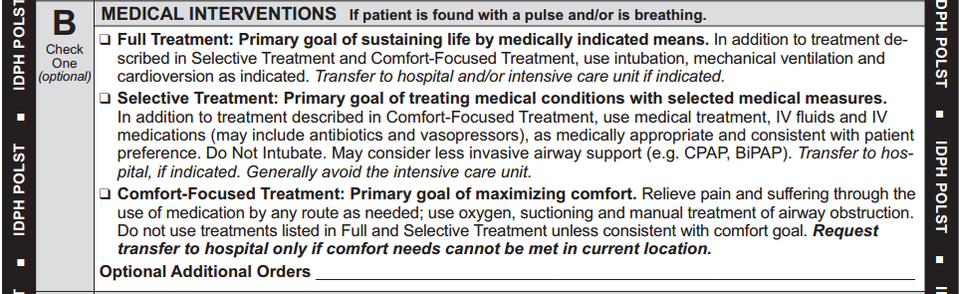
Section “B”: Medical Interventions
Section B documents what a person wishes to occur if they are found with a pulse and/or breathing present but unable to communicate; cardiac arrest may occur shortly. a pulse and/or are breathing:
The checked box explains patient’s goal for treatment and specifies which treatments the patient wants to have and avoid.
Notes:
SUGGESTED SCRIPT:
*** Section B applies in medical emergencies ASIDE FROM CARDIAC ARREST sometimes called a PREARREST EMERGENCY. These are situations when there is a heartbeat and breathing, but one, the other or both are deteriorating. These situations could lead to cardiac arrest if not responded to medically. The question in these circumstances is not whether the patient wants to be resuscitated, but rather what level of treatment or what medical interventions the patient wants—or does not want.
We will go into more specifics on the next slide.
TO THE PRESENTER:
If appropriate to the audience, suggest/discuss ways to introduce section B:
In a situation when you/the patient are critically ill and not able to communicate, but you have a pulse or are breathing, then medical professionals would look at Section B on a POLST form.
Section B is very important—it is the heart of POLST.
People who want to be DNR in Section A, choose all different options in Section B, so we need to discuss what you/the patient would want in this situation.

Slide 25
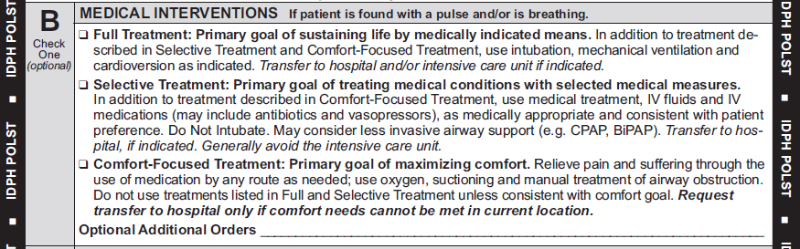
Section “B”: Medical Interventions
Full Treatment: Transfer me to the hospital and provide all appropriate treatment. I want to live as long as possible.
Must be selected when selecting CPR in section A
Either box may be marked in Section A
Notes:
SUGGESTED SCRIPT:
***Reiterate - It is very important to understand that Sections A & B are used in different situations, so DNR in Section A does not determine care when a person is critically ill but with a pulse and/or is breathing. In these medical emergencies, first responders will follow the orders in Section B.
SECTION B: Full Treatment - includes all medically indicated treatments for sustaining life including intubation, ventilation, cardioconversion, dialysis, surgery, etc. This will almost always mean transferring the patient to the hospital and providing care in the ICU if needed.
Here is an example -the same patient who chooses DNR in Section A, may also believe that if they are choking or having a severe asthma attack and are in need of an in-line neb or an advanced airway that would save their life and preserve their neurologic function, they may choose Full Treatment in Section B. In Section B, Full Treatment is not meant to also apply to cardiac arrest management.
Another example: let’s say someone has pneumonia and develops septic shock. They are willing to have all medical treatment aimed at reversing these processes. But given their severe, inoperable CAD, they understand that, should they have a cardiac arrest, even as a result of the sepsis, their prognosis for recovery significantly lowers. So they would like to try antibiotics, pressors, be in the ICU, on a vent if necessary, but would not want ACLS should their heart stop. That would be a situation where they would mark No CPR in section A and Full Treatment in Section B.
Please note, if a person chooses Attempt Resuscitation/CPR in section A, then the practitioner must mark – “Full Treatment” in Section B. To understand this, think about a person close to death who want CPR, you would not wait until after they died to try to save their life – you would give them all indicated treatments right away.
Do you have any questions?
NOTES FOR COACHING A POLST CONVERSATION:
If appropriate to the audience, suggest/discuss ways to explain “Full Treatment”:
If yes to CPR in Section A –
Since you have chosen to have emergency medical professionals attempt to resuscitate you/the patient by giving CPR when there is no pulse or breathing, then it follows that you also want full treatment if your/the patient’s heart has not stopped beating, no matter how critical your/the patient’s condition. Does this make sense?
If CPR did get your heart beating again, it is nearly guaranteed that you will be in the ICU on a ventilator for at least a short while. After that, if you did not show improvement and your doctor thought your chances of getting better were poor, would you still want to be kept alive on the ventilator?
If Yes – Mark “Full Treatment” in section B. Go to section C.
If No – Ask:
If your doctor does not think you/the patient are/is going to make a good recovery, we can write in Additional Orders – “Trial period to meet my goals.” Does that make sense?
Mark “Full Treatment” in Section B and complete the optional additional orders section.
If NO CPR in Section A:
It is important to understand each person’s goals and wishes to determine the best option in section B.
As your/the patient’s illness progresses, it is possible you/the patient may have critical health problems. If you/the patient got so sick that you/the patient were struggling to breathe, you/the patient might need to be put on a ventilator, which is a machine that will helps the lungs. The ventilator is not comfortable and will prevent you/the patient from communicating with people. Also, you/the patient would need to be in the intensive care unit of the hospital.
If you/the patient were that sick, would you/they want to go to the hospital and be placed on the ventilator?
If YES to Ventilator in Sec. B: Mark - Full Treatment, and continue:
If you/the patient are/is on the ventilator and not improving, and the doctor thinks your/their chances of getting better are very small, would you/the patient want to be kept alive on the ventilator for long time?
IF YES – do nothing else in section B. Go to section C.
IF NO – Add:
If your doctor does not think you are going to make a good recovery, we can write in Additional Orders – “Trial period to meet your goals. Does that make sense?
Complete the optional additional orders section.

Slide 26
Section “B”: Medical Interventions
Selective Treatment: Transfer me to the hospital for medical treatment, but I do not want to be on the ventilator.
Person could receive treatments such as:
  IV fluids; IV meds as appropriate
  May use CPAP, BiPAP, BVM
  Other treatments as needed to return to “baseline”
Notes:
SUGGESTED SCRIPT:
*** SECTION B: Selective Treatment – in general this means some or most indicated treatments will be provided to the patient except intubation/ventilation. For patients who choose this option, the goal is to avoid the ICU but attempt to return as much as possible to their baseline. Note that vasopressors can only be done in the ICU setting but may still be indicated under “Selective Treatment”. It may be especially important to discuss the specific treatments the patient wants and does not want if this option is chosen, for example – radiation/chemotherapy, dialysis, major surgery, etc.
An example of using this option is a patient with heart failure having severe shortness of breath. They may want a trial period of CPAP/BiPAP (IF INDICATED) but do not want to be intubated. This patient may be far more comfortable if we can provide noninvasive pressure support ventilations and/or position them appropriately to relieve their distress. King LTD, LMA, Combi tube are other examples of advanced airways that the patient generally intends to refuse if this box is marked.
Do you have any questions?
NOTES FOR COACHING A POLST CONVERSATION:
If appropriate to the audience, suggest/discuss ways to explain “Selective Treatment” in section B:
If NO to ventilator in Sec. B:
I understand you/the patient would not want to be put on a ventilator.
Some people still wish to go to the hospital for certain treatments if they will be able to recover and have a quality of life that is acceptable to them.
Other people reach a point when they would prefer not to go back to the hospital. They would prefer to stay home.
Tell me how you feel about your/the patient’s current quality of life and what kinds of treatment you/the patient would be willing to go through.
Determine if the person wants the types of medical treatments described in the “Selective Treatment” section. Explain these treatments as needed giving the person information about each treatment’s possible benefits and drawbacks. Use “optional Additional Orders” to indicate specific treatments the patient wishes to have or avoid and if a trial period is requested.
Mark - Selective Treatment: for persons wishing to be hospitalized (may include medical treatments including IV fluids and IV medications, and/or less invasive airway support) Specify any treatments to avoid in “Optional Additional Orders.”
Mark- Comfort-Focused Treatment: for persons wishing to stay at home and be kept comfortable without significant medical treatments.

Slide 27
Section “B”: Medical Interventions
Comfort-Focused Treatment: I want to be as comfortable as possible where I am but transfer me to the hospital if my pain or symptoms cannot be alleviated.
Notes:
SUGGESTED SCRIPT:
*** SECTION B: Comfort-Focused Treatment – this option is focused on relief of pain and other distressing symptoms rather than prolonging life. Interventions listed in Full and Selective Treatments will not be used if this option is selected. Transfer to a hospital should be avoided unless it is needed for symptom management.
A good example of this would be a hospice patient. “Please keep me out of pain but let me die at home.” One of the problems that EMS personnel face is being called to a home because the family does not know what to do when the patient deteriorates and end of life appears imminent. EMS responds and the family requests help, but they do not know what that help should be. EMS usually has to transport the patient even though patient’s wish is to not be transported. There is now a caveat written into the form states, “Transfer to hospital only if comfort needs cannot be met in current location.”
Any questions
NOTES FOR COACHING A POLST CONVERSATION:
If appropriate to the audience, suggest/discuss ways to explain “comfort-focused treatment” and provide examples of what comfort care looks like in different clinical situations.
“Comfort-focused treatment” does not mean that you/patient will go without care. – Any condition that makes you/patient uncomfortable will be addressed to make you/patient as comfortable as possible. This may even mean going to the hospital if necessary, to relieve suffering.

Slide 28
Section “B”: Comfort Focused Treatment
“Comfort-focused treatment” requires a clear explanation to the patient/substitute decision-maker:
Regardless of the option selected in section B, treatment for comfort is always provided – we never do nothing!
For example, if a person is choking, suction, manual treatment of airway, Heimlich maneuver would be implemented:
Choking is NOT COMFORTABLE!!
Notes:
SUGGESTED SCRIPT:
It is important to remember that -
No matter what treatments are indicated on the POLST Form, comfort care will always be provided so that the patient’s pain and other symptoms are managed.
Comfort-focused treatment can last for minutes, hours or days depending on the nature of the medical condition.
“Comfort-focused treatment” does not mean that certain conditions won’t be attended to – any condition that make the patient uncomfortable will managed in order to relieve suffering as much as possible. This might mean transporting the patient to the hospital if necessary.

Slide 29
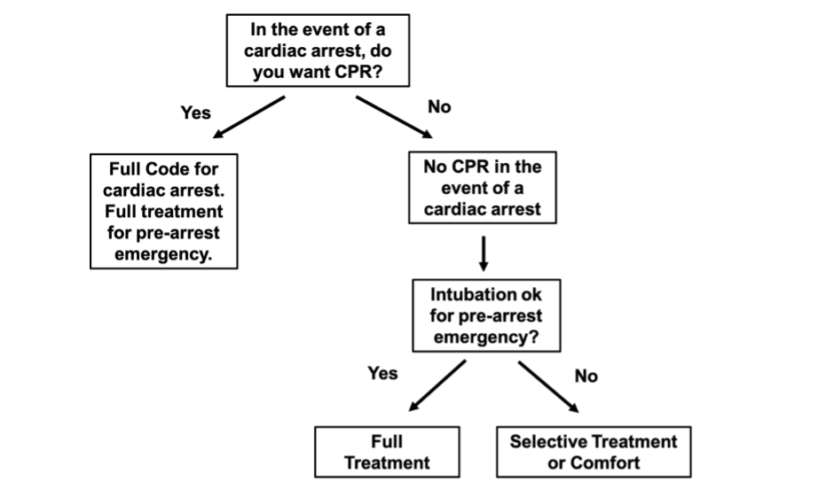
Another way to think about Sections A & B
Notes:
TO THE PRESENTER:
This is a very simplified version of acceptable POLST completion and should not be used as a model for the POLST discussion.

Slide 30
Section “B”: Medical Interventions
Optional Additional Orders - used to customize form for individual medical conditions when necessary
Notes:
SUGGESTED SCRIPT:
This is where the health care professional preparing the POLST form with the patient/substitute decision-maker can indicate specific treatments that should or should not be used and/or what circumstances should be considered in treatment decisions.

Slide 31

Section C: Medically Administered Nutrition
Although it isn’t critical for emergency care, it is very helpful for healthcare providers to know your wishes about feeding tubes, called medically administered nutrition.
Yes, I do want long-term artificial nutrition if I am no longer able to take foods or liquids by mouth
Trial period, I do want artificial nutrition for a trial period (see additional instructions)
No, I do not want long-term artificial nutrition if I am no longer able to take foods or liquids by mouth
Notes:
SUGGESTED SCRIPT:
*** Section C applies only in situations when the patient cannot communicate with medical professionals and when a feeding tube is being considered and is medically indicated.
Medically administered nutrition represents a considerable change in the patient’s way of life, so this section allows for a medical professional to discuss the patient’s goals of care and willingness to accept a feeding tube prior to a medical event that would necessitate this treatment.
The patient can choose to
Have a feeding tube over the long-term
Have a feeding tube for a trial period (indicating goals for the trial period) or
Refuse a feeding tube in all circumstances

Slide 32
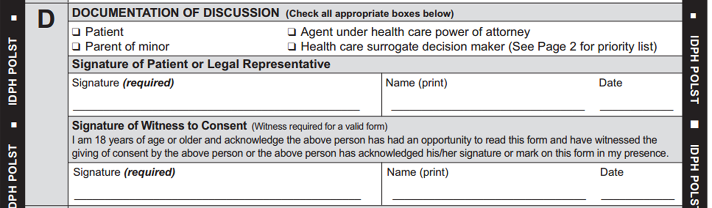
Section D: Documentation of Discussion
Need 2 signatures here
  Patient, agent (POAHC), or healthcare surrogate
  Witness to consent
If consented by patient’s legal representative, supporting documents verifying agent powers are NOT needed by EMS
Notes:
Anyone can witness the DNR/POLST form. The only restriction is that it cannot be the “Primary Care Giver”. The primary care giver is the practitioner that is directing the patient’s care. All other medical personnel are carrying out the practitioner’s orders so can witness the form if needed.

Slide 33
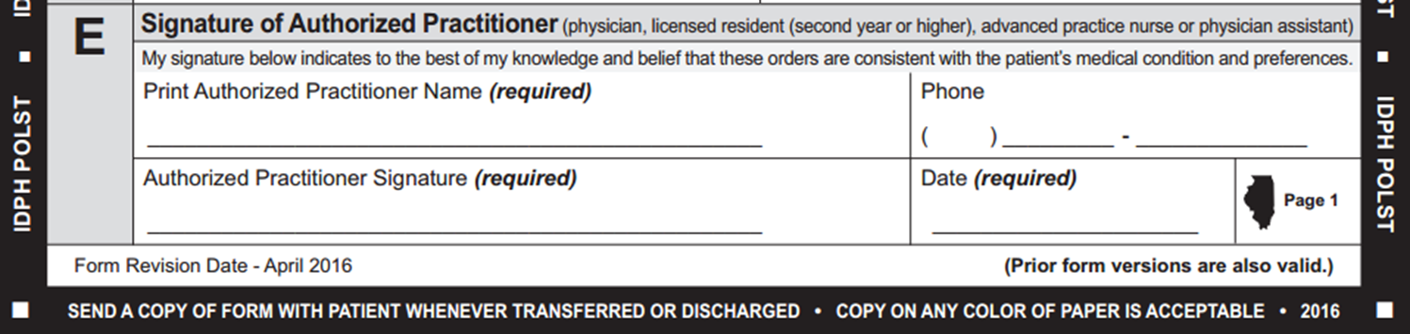
Section E: Signature of Practitioner
Must have practitioner’s name, signature, and effective date to be valid. Verbal orders are allowable.
Practitioner’s signature may be written by a nurse who adds her/his own initials - acceptable and form is valid

Slide 34
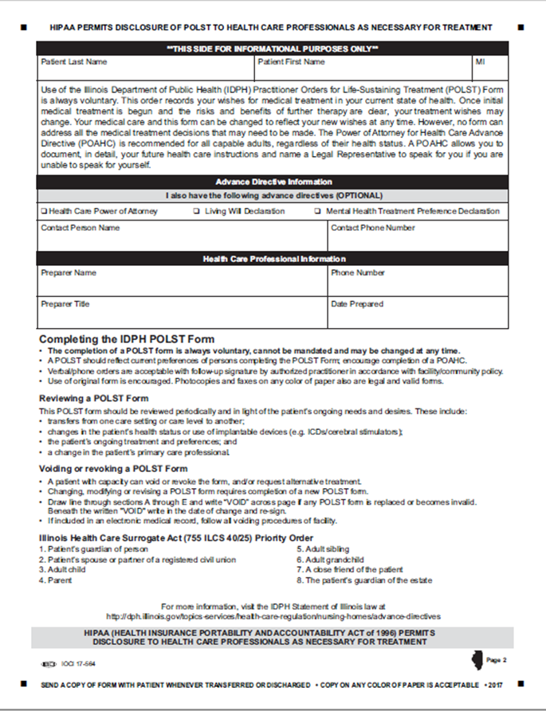
Back Page – EMS does not take action
Completing the back page of the POLST form is optional
Form is valid if only first page.
Information is helpful in identifying next of kin/emergency contact information.
Notes:
SUGGESTED SCRIPT:
The back page of the IDPH Uniform POLST Form is for informational purposes only. ***The form is valid even if left blank or not included.
Fields on the back page include:
patient’s name
information about the existence of the patient’s advance directives
identity of the person who conducted the POLST conversation and prepared the form with the patient or substitute decision maker
Guidance at the bottom of the back page includes information about:
Completing a POLST Form
Reviewing a POLST Form periodically after completion
Revoking or voiding a POLST Form
The IL Health Care Surrogate Act order of priority for decision makers

Slide 35

Case 1: John
A 60-year-old with metastatic prostate cancer who was previously able to live at home and manage his own ADLs. He has been in and out of the hospital frequently, and a Palliative Care consult has been ordered. Upon goals of care conversation with the patient, you learn that he recognizes his illness is terminal, and for that reason does not wish to undergo CPR in case of cardiac arrest. He also does not want to be intubated should he suffer a primary respiratory arrest. However, as his quality of life is still good, he is willing to attempt low burden, less-invasive measures to prolong his life.
Notes:
TO THE PRESENTER:
Discuss with the group how the POLST form sections A and B would be completed.

Slide 36

Case 2: Harold
A 75-year-old with late-stage COPD, who when recently hospitalized was intubated and successfully extubated and is being discharged to home. Upon conversation with the patient, you learn that the patient understands that should he suffer a cardiac arrest (no breathing, no pulse, unresponsive), the odds of his surviving an attempt at resuscitation are slim, and he does not want to have CPR attempted, However, he is willing to be intubated should he suffer a potentially reversible condition, such as pneumonia, that renders him temporarily unable to breath on his own.
Notes:
TO THE PRESENTER:
Discuss with the group how the POLST form sections A and B would be completed.

Slide 37

Case 3: Ellen
An 85-year-old woman with advanced dementia who presents to the ED with increased confusion and lethargy. Her husband gives admission staff documents that show he is the POAHC. A social worker referral is placed to discuss health care wishes and plans. You find the husband is anxious to document her strong wishes that under no circumstances does she want to have artificial nutrition through a tube, even temporarily, and she doesn’t want to be resuscitated for any reason.
Notes:
TO THE PRESENTER:
Discuss with the group how the POLST form sections A and C would be completed. What do we know about completing Section B?

Slide 38
Applying the POLST Program

Slide 39
Review and Revision of POLST
POLST forms should be reviewed and updated periodically when the patient:
  is transferred between ICU and general medical unit;
  has a substantial change in clinical condition;
  changes treatment preferences or goals of care
The POLST conversation should be repeated before documenting new treatment decisions or confirming current treatment decisions

Slide 40
POLST in COVID-19 Pandemic
COVID-19 is particularly risky for frail and chronically ill nursing home residents:
POLST is for a limited population: facilities and providers should offer this population the opportunity to have or review a POLST form right away
Specifically discuss the potential risks and benefits of treatments considering COVID-19, and revise the POLST form if desired
Document patient treatment preferences even if it may not be possible to honor all preferences depending on available resources
POLST forms should not have expiration dates even considering COVID-19
POLST forms can be changed if lower/higher risk of COVID-19
effects goals of care
Notes:
TO THE PRESENTER:
Review slide as written

Slide 41
NOT Recommended for
Organizational POLST Policies
Mandating completion of POLST forms
Providing incentives for POLST form completion
Completing a form without meaningful conversation first
Giving a person a POLST form to complete for themselves
Completing POLST form without patient/substitute decision-maker knowledge
Signing POLST form for patient/substitute decision-maker
Never reviewing completed POLST forms
Organizational failure to evaluate use of POLST
Notes:
***SUGGESTED SCRIPT:
POLST form completions is ALWAYS voluntary. Never communicate that POLST completion is a mandatory part of hospice enrollment, nursing home admission or the provision of care, and never coerce a patient/substitute decision-maker into completing a POLST form.
2. Because POLST is voluntary, it’s completion should not be part of a Service Level Agreement (SLA) or quality performance measure (requires % of ACP in place). It should not be tied to salary incentives for % of ACP documents in EHR. This treats POLST and Advance Directives as the same document and ignores personal autonomy.
3. Remember the importance of the conversation and make sure to explore all the issues suggested in this training before completing the form with the patient/substitute decision-maker.
4. POLST is a medical order and requires a high degree of health literacy to understand. It always needs to be completed with a health care professional in conversation with a patient/substitute decision-maker.
5. & 6. You would never pre-sign a medical order/Rx or provide treatment without consent; your license is on the line in this situation too.
7. Things change over time, including a patient’s goals of care, prognosis, health status, treatment options, and preferences for treatments. It is well known that some patients change their mind about treatment options over the trajectory of their illness or want their substitute decision-maker to be able to consider their values when their condition or prognosis changes. The POLST form is intended to be dynamic, reflecting a patient’s current preferences about the medical treatments he/she wants to receive. This dynamic process is achieved through ongoing conversations when a POLST form review is completed: upon changes in patient’s goals of care, medical condition, level of care, or location.
8. Organization should have policies relating to POLST that include evaluating the quality of its practices and documents. QUALITY IMPROVEMENT RESOURCES are available through the National and State POLST organizations.

Slide 42
POLST – Statutory Issues &
IDPH Guidance
Disclaimer: this presentation cannot provide legal advice; it is intended for informational purposes only.
Notes:
SUGGESTED SCRIPT:
The POLST IL Committee and Illinois Department of Public Health has provided this presentation with the intent of its use being for informational purposes only. Because each individual situation is different and key facts can so often change the outcome, additional questions should be directed to a licensed attorney, this presentation cannot provide legal advice.

Slide 43
Surrogate vs. POAHC Consent to POLST
Is a written, accessible, and valid POAHC document available?
If no:
Establish and document who is surrogate decision-maker
If yes:
POAHC discusses & consents to POLST
Establish & document pt. non-decisional
Discuss POLST.
Will POLST allow for all LST?
If no:
Establish & document: pt. non-decisional; qualifying condition; witness attestation
Surrogate consent to POLST
(limits LST)
If yes:
Surrogate consents to POLST.
(allows all LST)
Notes:
***SUGESTED SCRIPT:
When a person is not decisional and you are utilizing a Healthcare Surrogate vs a POAHC to complete and sign a POLST form, the process has key differences to be aware of. The process is also influenced by whether life-sustaining treatment will be limited vs. allowed.
It is vital to note the type of information a healthcare provider must established and documented when working through this process.
Outcomes that may result from following the above process-flow on screen.
POAHC consents to POLST (all or limited LST)
Healthcare Surrogate consents to allow all LST
Healthcare Surrogate consents to limit LST
This is a reference and framework to work from, the nuances and details of real-life may have additional considerations that must be accounted for.

Slide 44
Voiding or Changing a POLST
Patient who regains decisional capacity:
Power of Attorney for Health Care (always) & Surrogate (if no existing POLST):
Best interest of patient if wishes are not known/documented in AD
Health Care Surrogate if existing POLST consented to by patient themselves:
Must consult with attending practitioner
Encourage “substituted judgment standard” document in patient’s POLST
Document new information known about patient’s wishes in EHR
POLST is no longer consulted.
Patient should revisit POLST conversation and potentially revise form.
Substituted judgement if wishes are known/documented in AD
Can void and/or complete a new POLST for non-decisional patient as conditions change
Notes:
An individual or his or her legal representative can revoke a DNR or POLST order at any time. Above we have specific situations when this instance may occur and considerations to keep in mind. [Review Slide]
Sometimes there may be other unseen influences or dynamics involved in an individual’s life which may lead an individual to consider revoking the DNR or POLST order. It is often beneficial that they have the opportunity to speak with an appropriate healthcare provider first to assure understanding of the situation, what is being consented to and the potential outcomes of decisions made.
Ways to revoke:
The POLST order can be revoked in a variety of ways. Such as by using “VOID”, creating a new, or destroying the document including all copies. The revocation decision also should be communicated to the Patient’s healthcare professionals, family members, and to anyone that may have a copy of the original form.
Voiding method: Writing a diagonal line & “VOID” on each page, Individual signs and dates each page. Individual keeps the original voided form, a copy of the voided form should be put into the Patient medical record and provided to the Patient’s healthcare professionals, family members and to anyone that may have a copy of the original form.
Creating a New: Completion of valid new/more recently dated POLST supersedes an older dated POLST (does not make the previously completed POLST invalid).
Destroying the document and all copies: not a great option as this can be very difficult to know it was done and can lead to confusion.
Bonus: Optional Cover Letter (secondary measure and for clarity purposes)
Along with the voided form, individual could submit a cover letter stating the intention to revoke the form dated ________ and not replace it. Letter could be signed/dated by individual, witnessed by staff, and accompany the voided document.

Slide 45
Valid POLST Forms
  Properly executed prior versions of the IDPH Uniform DNR or the DNR/POLST Advance Directive are still valid. Most recently dated is followed.
  Photocopies of forms are valid.
  Picture of POLST form on electronic device is valid.
Notes:
TO THE PRESENTER:
Cover all the bullets on the slide.
Each health care facility may have different policies on whether copies of DNR or POLST orders completed on a form other than an IDPH Uniform POLST Form are accepted as valid. It is advisable to check with a health care facility regarding its DNR or POLST policy.

Slide 46
Requirements for a Valid POLST Form
REQUIRED
Section A
3 Signatures:
1) Patient or legal substitute decision-maker
2) Witness
3) Practitioner
Patient Identifying Information
OPTIONAL
All other information optional
All indicated treatment used where a decision is unspecified
Pink paper recommended to enhance visibility, but color does not affect validity of form
Date of Practitioner Signature
Notes:
SUPPLEMENTAL SCRIPT:
***Verbal/phone orders from a practitioner are acceptable BUT should be signed at the earliest opportunity to ensure the order is followed.
Pink paper is recognizable BUT does not scan well.

Slide 47
QUESTION & ANSWER

Slide 48
POLST Resources
For POLST Illinois information:
polstIllinois@gmail.com
www.polstil.org
National POLST Program
www.polst.org
Notes:
TO THE PRESENTER:
Review information on the slide and ask for final questions. Any outstanding issues can be communicated to IL POLST through the website.

Slide 49
Resources for “the conversation”
https://www.theconversationproject.org/
https://respectingchoices.org/
https://www.ariadnelabs.org/areas-of-work/serious-illness-care/resources/#Downloads&%20Tools
https://pact.northwestern.edu/
https://www.vitaltalk.org/
Notes:
TO THE PRESENTER:
Share these websites and resources for learning how to conduct a POLST goals of care discussion.

Slide 50


This presentation created by the POLST Illinois Education Committee has been made possible by in-kind and other resources provided by:
Notes:
Our logo
National logo & IL-HPCO

Slide 51
Evolution of the IDPH Uniform POLST Form
“Orange”
DNR Form
2000
IDPH Uniform DNR Order Form
2006
IDPH Uniform DNR-Advance Directive
2007
POLST Language Added
2013
Practitioner Signature Expanded
2015
IDPH Uniform POLST Form
2016
Current Form Language
2017
National POLST Form
2019
Notes:
TO THE PRESENTER:
Keep this explanation short and sweet.
SUPPLEMENTAL SCRIPT:
The form started in 2000 as the original “orange DNR form” and has gone through a number of changes over the years to reach its current status as the “IDPH Uniform POLST form”. This is the sixth version and offers patients and providers both more options and more concrete guidance.
2000: 1st Illinois EMS DNR “orange form”; only for EMS, order had to be rewritten at each new facility
2005: IDPH Uniform DNR Order form - applied to all facilities
2006: Confusion if form had to be used for every in-hospital DNR order (no); renamed IDPH Uniform DNR Advance Directive
2013: Remained IDPH DNR Advance Directive, but used shorthand POLST “paradigm” for life-threatening emergencies
2015: IDPH DNR/POLST- Other practitioners can sign
2016: DNR removed from title; care options redefined
2017: Current language and law established
***2018: National POLST Paradigm form approved by national organization. NOT approved for use in IL, but you may come across this form in practice if a patient completed the form elsewhere.

Slide 52
Additional Criteria for Evaluating Appropriate Use of POLST
Patients with a serious life-limiting medical condition or advanced frailty:
  whose health care professional would not be surprised if they died within 1-2 years; or
  who are at an increased risk of experiencing a medical emergency based on their current medical condition and who wish to make clear their treatment preferences, including about CPR, mechanical ventilation, ICU; or
  who have had multiple unplanned hospital admissions in the last 12 months, typically coupled with increasing frailty, decreasing function, and/or progressive weight loss.

Slide 53
National Support for POLST:
Landmark Study JAGS 2014
Study on the relationship between what POLST orders are selected and where people ultimately die. 18,000 death records (2010-2011) reviewed from Oregon’s electronic POLST registry
Relationship between options selected on the POLST form and where people die:
  6.4% of persons who had a POLST Form specifying Comfort Measures Only treatment wishes died in a hospital
  22.4% for persons who wished for Limited Additional Interventions died in a hospital
  44.2% of persons whose POLST specified wishes for Full Treatment died in a hospital
  34.2% of persons without a POLST Form died in a hospital
  (Fromme, Erik, et.al., “Association Between Physician Orders for Life-Sustaining Treatment for Scope of Treatment and In-Hospital Death in Oregon”, JAGS, Vol. 62, No. 7, July 2014, pp 1246–1251.)
Notes:
TO THE PRESENTER:
Review study explained on the slide.
Researchers examined 18,000 death records of individuals having a valid POLST form in the Oregon POLST Registry who had died of natural causes in Oregon between 2010 and 2011. The study compared the treatment wishes recorded on the person’s POLST Form to their location of death.

